Slide 1
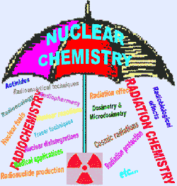
NUCLEAR CHEMISTRY

Slide 2
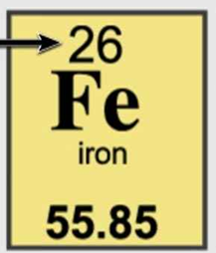
ATOMIC STRUCTURE REVIEW
Fill in the chart below.
Element | # of neutrons | # of protons | # of electrons | Atomic # | Mass #
Scan-dium
Iron
24
21
21
21
45
28
26
26
26
54

Slide 3
MOLE CONVERSION REVIEW
How many moles of aluminum are 3.7 x 10²¹ atoms of aluminum?
3.7 x 10²¹
atoms Al
__
1
mole Al
__
6.022 x 10²³
atoms Al
atoms Al
(0.0061)

Slide 4
MOLE CONVERSION REVIEW
How many molecules of CO₂ are in 22.0 grams of CO₂?
6.022 x 10²³
__
22.0 grams CO₂
molecules CO₂
molecules CO₂
44.0
_
grams CO₂
(3.01 x 10²³)

Slide 5
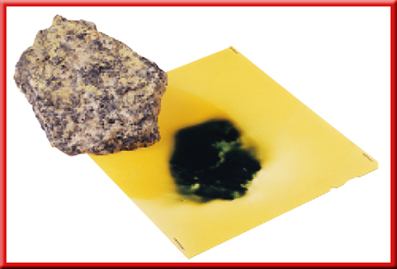
Nuclear Chemistry
Nuclear chemistry is the study of the structure of atomic nuclei and the changes they undergo.

Slide 6
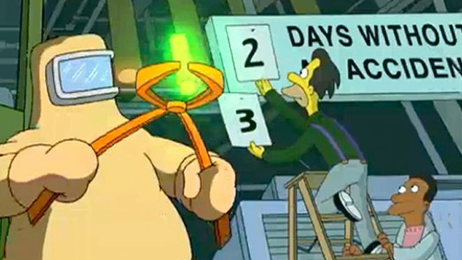
Nuclear Reactions
There are three different types of nuclear reactions: radioactive decay, fission, and fusion.

Slide 7
Radioactive Decay
Radioactive decay is a type of nuclear reaction which involves atoms that undergo radioactive (alpha, beta, and gamma) decay.
Unstable nuclei spontaneously emit radiation to attain more stable atomic configurations.

Slide 8
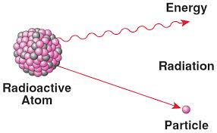
Radioactive Decay
During radioactive decay, unstable atoms lose energy by emitting one of several types of radiation.

Slide 9
Radioactive Decay
Nuclear decay is a random event.
This is very much like popping popcorn. When we pour popcorn kernels into a popcorn popper, there is no way to know which kernel will pop first. And once that first kernel pops, it will never be a kernel again...it is forever changed!

Slide 10
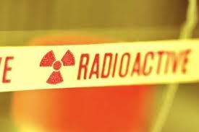
Types of Radiation
The three most common types of radiation are alpha (α), beta (β), and gamma (γ).

Slide 11
Types of Radiation
Name Symbol Formula Mass Charge Description
4
He
4
+2
helium nuclei
alpha
α
2
0
high speed electrons
beta
β
e
0
-1
-1
γ
high energy radiation
gamma
0
0

Slide 12
Alpha
An alpha particle (α) has the same composition as a helium nucleus—two protons and two neutrons—and is therefore given the symbol .
The charge of an alpha particle is 2+ due to the presence of the two protons.

Slide 13
Alpha
Because of their mass and charge, alpha particles are relatively slow-moving compared with other types of radiation.
Thus, alpha particles are not very penetrating—a single sheet of paper stops alpha particles.

Slide 14
Beta
A beta particle is a very-fast moving electron that has been emitted from a neutron of an unstable nucleus.
Beta particles are represented by the symbol
The zero superscript indicates the insignificant mass of an electron in comparison with the mass of a nucleus.

Slide 15
Beta
The –1 subscript denotes the negative charge of the particle.
Beta radiation consists of a stream of fast-moving electrons.

Slide 16
Beta
Because beta particles are both lightweight and fast moving, they have greater penetrating power than alpha particles.
A thin metal foil is required to stop beta particles.

Slide 17
Gamma
Gamma rays are high-energy (short wavelength) electromagnetic radiation. They are denoted by the symbol .
As you can see from the symbol, both the subscript and superscript are zeroes.

Slide 18
Gamma
Thus, the emission of gamma rays does not change the atomic number or mass number of a nucleus.

Slide 19
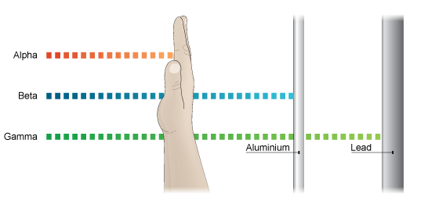
Gamma
Gamma rays are the most penetrating.
Concrete, lead, or steel must be used to block gamma rays.

Slide 20
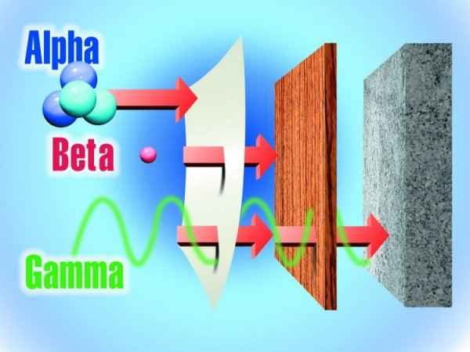
Radiation

Slide 21
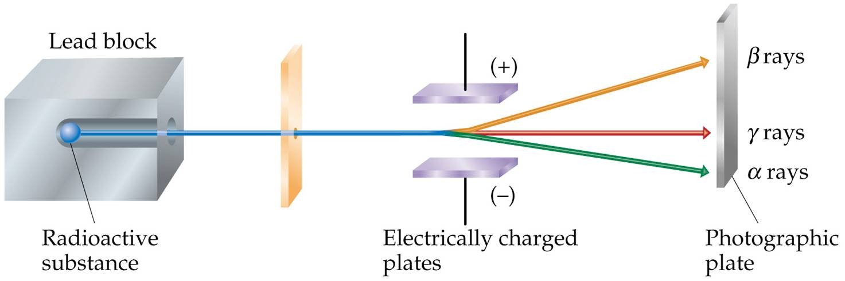
Types of Radiation
Alpha, Beta or Gamma?
??
??
??

Slide 22
Types of Radiation
Negatively charged beta particles are deflected toward the positively charged plate.
??
??
??

Slide 23
Types of Radiation
Positively charged alpha particles are deflected toward the negatively charged plate.
??
??

Slide 24
Types of Radiation
Gamma rays, which have no electrical charge, are not deflected.
??

Slide 25
Types of Radiation
In an electric or magnetic field, alpha particles are deflected less than beta rays because they are more massive.

Slide 26
Nuclear Stability
Radioactive nuclei undergo decay in order to gain stability.
All elements with atomic numbers greater than 83 are radioactive.

Slide 27
Balancing a Nuclear Equation
Nuclear equations are used to show nuclear transformations.
Balanced nuclear equations require that both the atomic number and the mass number must be balanced.

Slide 28
Balancing a Nuclear Equation
Mass number
A
A
X
X
Z
Z
Element symbol
Atomic number

Slide 29
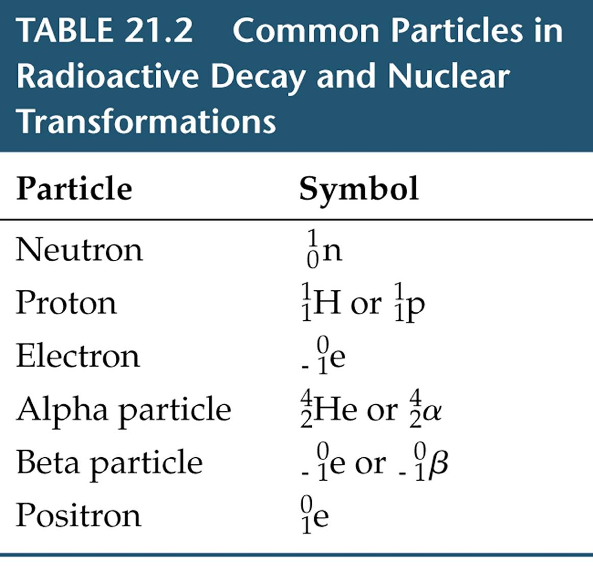
Balancing a Nuclear Equation

Slide 30
Balancing a Nuclear Equation
1. When beryllium-9 is bombarded with alpha particles (helium nuclei), a neutron is produced. The balanced nuclear reaction is given as:
9
4
1
Be + He → n +
???
4
2
0

Slide 31
Balancing a Nuclear Equation
9
4
1
12
Be + He → n +
???
4
2
0
On the reactant side, the mass numbers equal (9 + 4) = 13.
On the product side, the mass number equals 1.
The product side needs an additional 12 for the mass number.

Slide 32
Balancing a Nuclear Equation
9
4
1
12
Be + He → n +
4
2
0
6
On the reactant side, the atomic numbers equal (4 + 2) = 6.
On the product side, the atomic number equals 0.
The product side needs an additional 6 for the atomic number.

Slide 33
Balancing a Nuclear Equation
9
4
1
12
Be + He → n +
4
2
0
6
The atomic number (the number on the bottom) determines the identity of the element.

Slide 34
Balancing a Nuclear Equation
9
4
1
12
Be + He → n +
C
4
2
0
6
The element with an atomic number of 6 is carbon.

Slide 35
Balancing a Nuclear Equation
2. When nitrogen-14 is bombarded with a neutron, a proton is produced. The balanced nuclear equation can be written as:
14
1
1
N + n → p +
???
7
0
1

Slide 36
Balancing a Nuclear Equation
14
1
1
14
N + n → p +
???
7
0
1
On the reactant side, the mass numbers equal (14 + 1) = 15.
On the product side, the mass number equals 1.
The product side needs an additional 14 for the mass number.

Slide 37
Balancing a Nuclear Equation
14
1
1
14
N + n → p +
7
0
1
6
On the reactant side, the atomic numbers equal (7 + 0) = 7.
On the product side, the atomic number equals 1.
The product side needs an additional 6 for the atomic number.

Slide 38
Balancing a Nuclear Equation
14
1
1
14
N + n → p +
7
0
1
6
The atomic number (the number on the bottom) determines the identity of the element.

Slide 39
Balancing a Nuclear Equation
14
1
1
14
N + n → p +
C
7
0
1
6
The element with an atomic number of 6 is carbon.

Slide 40
Balancing a Nuclear Equation
3. Thorium-230 undergoes alpha decay.
230
4
226
???
Ra
Th → He +
90
2
88

Slide 41
Balancing a Nuclear Equation
4. Uranium-234 undergoes alpha decay.
234
4
230
???
U → He +
Th
92
2
90

Slide 42
Balancing a Nuclear Equation
5. Cobalt-50 undergoes beta decay.
50
0
50
???
Co → e +
Ni
27
-1
28

Slide 43
Question 6
What element is formed when undergoes beta decay? Give the atomic number and mass number of the element.

Slide 44
Question 7
Write a balanced nuclear equation for the alpha decay of the following radioisotope.
235
4
231
U → He + Th
92
2
90

Slide 45
Question 8
Nitrogen-12 decays into a positron and another element. Write the balanced nuclear equation.
12
0
12
N → e + C
7
1
6

Slide 46
Question 9
Uranium-238 is bombarded with a neutron. One product forms along with gamma radiation. Write the balanced nuclear equation.
238
1
239
U + n → U + γ
92
0
92

Slide 47
Question 10
Nitrogen-14 is bombarded with deuterium (hydrogen-2). One product forms along with an alpha particle. Write the balanced nuclear equation.
14
2
12
4
N + H → C + He
7
1
6
2

Slide 48
STOP HERE

Slide 49
Radioactive Decay Rates
Radioactive decay rates are measured in half-lives.
A half-life is the time required for one-half of a radioisotope’s nuclei to decay into its products.

Slide 50
Radioactive Decay Rates
For example, the half-life of the radioisotope strontium-90 is 29 years.
If you had 10.0 g of strontium-90 today, 29 years from now you would have 5.0 g left.
The decay continues until negligible strontium-90 remains.

Slide 51
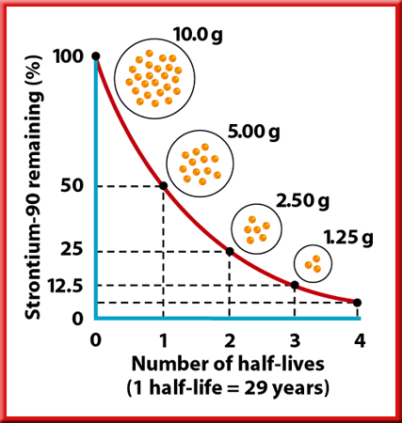
Radioactive Decay Rates
The graph shows the percent of a stontium-90 sample remaining over a period of four half-lives.
With the passing of each half-life, half of the strontium-90 sample decays.

Slide 52
Radioactive Decay Rates
Chemical reaction rates are greatly affected by changes in temperature, pressure, and concentration, and by the presence of a catalyst.
In contrast, nuclear reaction rates remain constant regardless of such changes.
In fact, the half-life of any particular radioisotope is constant.

Slide 53
Calculating Amount of Remaining Isotope
11. Iron-59 is used in medicine to diagnose blood circulation disorders. The half-life of iron-59 is 44.5 days. How much of a 2.000-mg sample will remain after 133.5 days?

Slide 54
11. Iron-59 is used in medicine to diagnose blood circulation disorders. The half-life of iron-59 is 44.5 days. How much of a 2.000-mg sample will remain after 133.5 days?
See if the problem tells you the starting amount.
See if the problem tells you the half-life time.
Did the problem give you the final time or final amount?
Time (days) | Amount (mg)
Take the half-life time and multiply it by 2, then by 3, etc. to get the total time.
Now cut the amount in half for each row.
0
2.000
44.5
1.000
89
0.500
(0.250 mg)
133.5
0.250

Slide 55
Question
12. Cobalt-60 has a half-life of 5.27 years. How much of a 10.0 g sample will remain after 21.08 years?
(0.625 g)

Slide 56
Question
13. If 100.0 g of carbon-14 decays until only 25.0 g of carbon is left after 11,460 yr, what is the half-life of carbon-14?

Slide 57
13. If 100.0 g of carbon-14 decays until only 25.0 g of carbon is left after 11,460 yr, what is the half-life of carbon-14?
Since you have the starting mass and final mass, cut the amount in half for each row until you reach the final amount.
Take the total time and divide by the number of times you cut the mass in half.
This problem tells you BOTH, the final amount and final time.
Now see if the problem tells you the final amount or final time.
Input the time that corresponds with the final amount.
See if the problem tells you the starting amount.
See if the problem tells you the half-life time.
Time (yr) | Amount (g)
This problem does not.
11,460 / 2
0
100.0
50.0
11,460
25.0
(5730 yr)

Slide 58
Question
14. What is the half-life in days of an isotope if 125 grams of a 1000 gram sample remain after 15 days?
(5 days)

Slide 59
Question
15. What is the half-life in years of an isotope if 1 gram of a 16 gram sample remains after 16 years?
(4 years)

Slide 60
Question
16. The half-life of hafnium-156 is 0.025 s. How long will it take a 560 g sample to decay to one-fourth its original mass?

Slide 61
16. The half-life of hafnium-156 is 0.025 s. How long will it take a 560 g sample to decay to one-fourth its original mass?
Now cut the amount in half for each row until you reach the final amount.
See if the problem tells you the starting amount.
See if the problem tells you the half-life time.
See if the problem tells you the final amount.
time | amount
Now double the time for each used row.
0
560
0.025
280
(0.050 s)
0.050
¼ (560) = 140

Slide 62
Question
17. Chromium-48 has a short half-life of 21.6 h. How long will it take 360.00 g of chromium-48 to decay to 11.25 g?
(108 h)

Slide 63
Question
18. If the half-life of uranium-235 is 7.04 x 10⁸ yr and 12.5 g of uranium-235 remain after 2.82 x 10⁹ yr, how much of the radioactive isotope was in the original sample?
(200 g)

Slide 64
Question
19. Carbon-14 has a half-life of 5730 years. How much of a 250. g sample will remain after 5730 years?
(125 g)

Slide 65
Nuclear Reactions
A second type of nuclear reaction is fission.
The basic difference in radioactive decay and fission is that in radioactive decay, an unstable isotope spontaneously undergoes a nuclear change.

Slide 66
Nuclear Reactions
In nuclear fission, a fissionable isotope absorbs a neutron, becomes unstable, and then fissions by breaking into a couple of pieces and releasing one or more neutrons plus a large amount of energy.
Nuclear fission is usually thought of as intentionally caused.

Slide 67
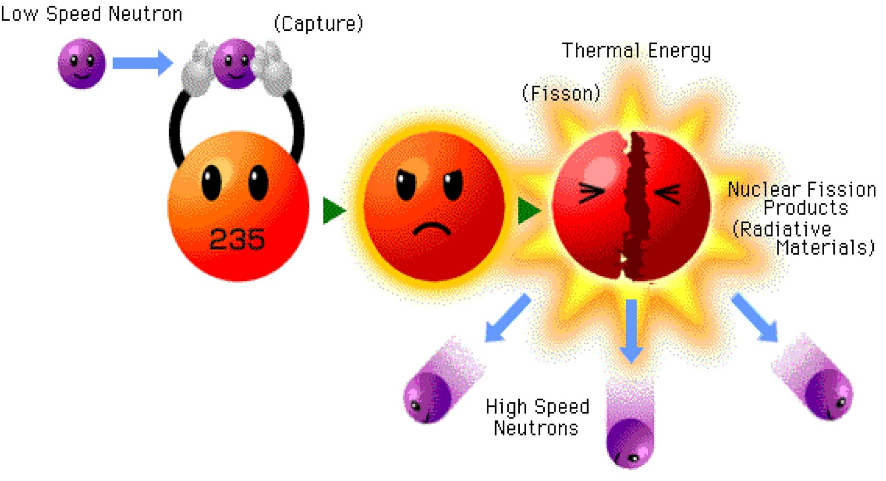
Nuclear Fission
Heavy atoms (mass number > 60) tend to break into smaller atoms, thereby increasing their stability.

Slide 68
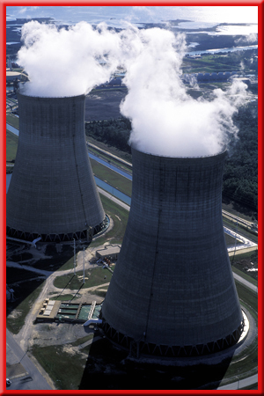
Applications of
Nuclear Fission
Nuclear power plants use the process of nuclear fission to produce heat in nuclear reactors.

Slide 69
Nuclear Fusion
The third type of nuclear reaction is fusion, which is the combining of atomic nuclei.
Fusion reactions can release very large amounts of energy but require extremely high temperatures.

Slide 70
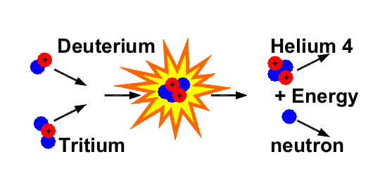
Nuclear Fusion
For example, nuclear fusion occurs within the Sun, where hydrogen atoms fuse to form helium atoms.

Slide 71
Question
20. What is the main difference between nuclear fusion and nuclear fission?
Nuclear fusion is the combining of nuclei to form a single nucleus. Nuclear fission is the splitting of a nucleus into fragments.

