Slide 1
Properties of Solutions

Slide 2
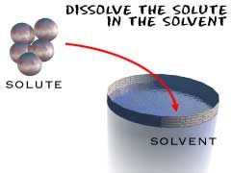
A Solution
A solution is made up of a solute and a solvent.
The solvent does the dissolving.
The solute is the substance that is dissolved.
Draw Picture:
Ex. Salt Water Solution
Salt=Solute
Water=Solvent
Notes:
‹#›

Slide 3
A Solution
If a solution is made of two liquids, the one in lesser quantity is the solute.
Notes:
‹#›

Slide 4
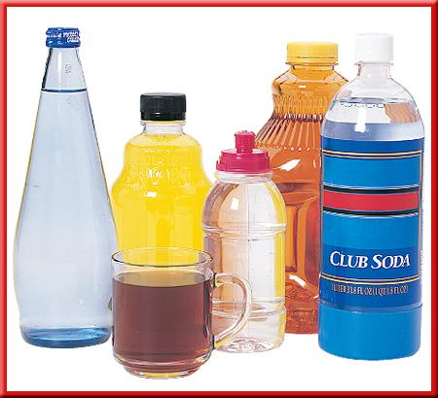
The Universal Solvent
Water is the universal solvent.
Water is a versatile solvent because of its attraction to other molecules and its polarity.
Notes:
‹#›

Slide 5
Water

Slide 6
Solutions
Solutions are homogeneous mixtures in a single phase (either solid, liquid or gas).
Notes:
‹#›

Slide 7
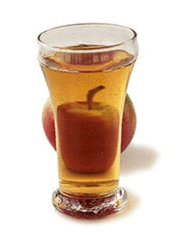
Solutions
Salt water, apple juice and dust free air (mixture of nitrogen, oxygen, argon, carbon dioxide, water vapor and other
gases) are examples of homogeneous
mixtures.
Notes:
‹#›

Slide 8
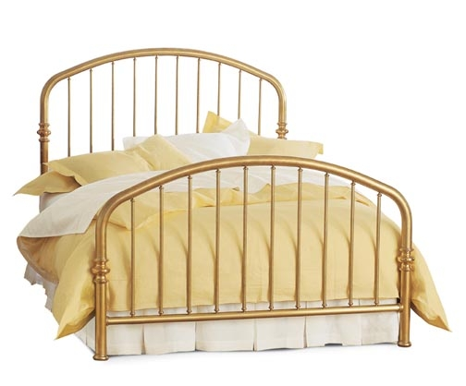
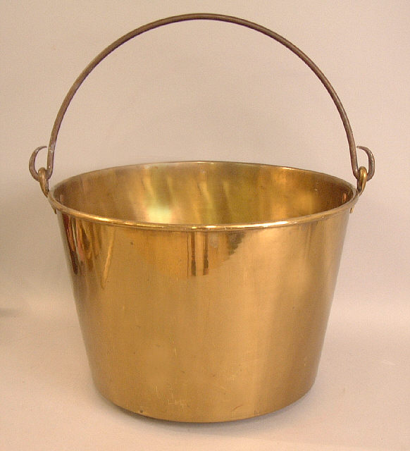
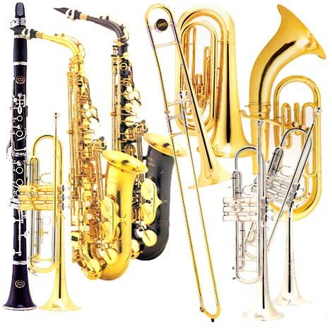
Solutions
Brass (solid mixture of copper and zinc) is also a homogeneous mixture.
Brass is an alloy, which is a mixture of metals.

Slide 9
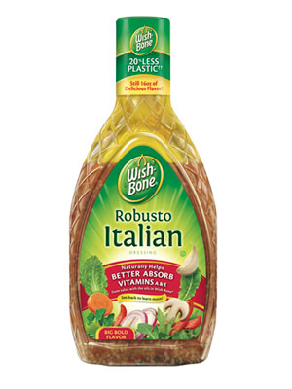
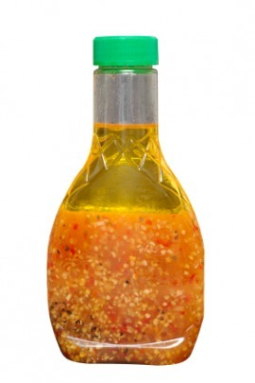
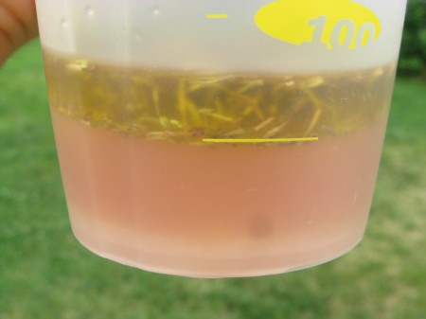
Solutions
Oil and vinegar salad dressing is NOT a solution.

Slide 10
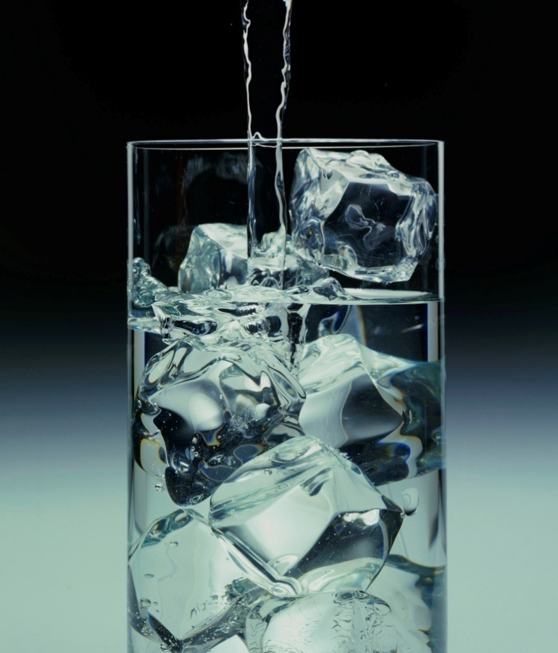
Solutions
Ice water is NOT a solution. Why??
Notes:
‹#›

Slide 11
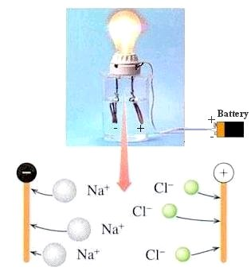
Salt Solutions
Table salt (NaCl), like a great many ionic compounds, is soluble in water.
The salt solution is also an excellent conductor of electricity (an electrolyte).
Notes:
‹#›

Slide 12
Salt Solutions
Free ions (such as Na⁺¹ and Cl⁻¹) in the solution are able to conduct the electricity and make the light bulb burn brightly.
Notes:
‹#›

Slide 13
Salt Solutions

Slide 14
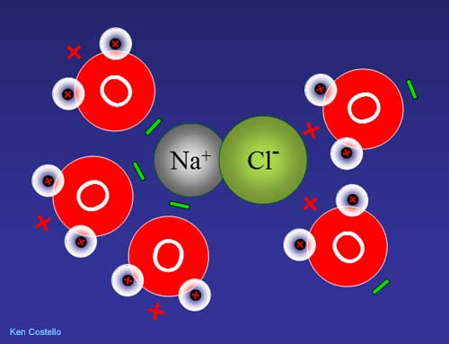
Dissociation
When a salt dissolves (dissociates) in water, the cation (positive ion) of the salt is attracted to the oxygen ion (negative ion) of the water.

Slide 15
Dissociation
The anion (negative ion) of the salt is attracted to the hydrogen ion (positive ion) of the water.

Slide 16
Other Solutions
Water is not only good at dissolving ionic substances. It also is a good solvent for many covalent compounds.
Consider the covalent substance sucrose, commonly known as table sugar, as an example.
Notes:
‹#›

Slide 17
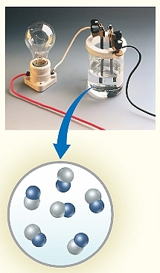
Other Solutions
When sugar dissolves in water, there are no free ions to conduct electricity.
The resulting solution is a nonelectrolyte, so the light bulb does NOT light up.
Notes:
‹#›

Slide 18
Making Solutions
A soluble substance dissolves faster if
it is stirred or shaken,
the particles are made smaller, and
the temperature is increased.
Notes:
‹#›

Slide 19
Making Solutions
In order to dissolve the solvent molecules must come in contact with the solute.
Stirring moves fresh solvent next to the solute.
The solvent touches the surface of the solute.
Smaller pieces increase the amount of surface of the solute.

Slide 20
Temperature and Solutions
For solids in liquids, as the temperature goes up the solubility goes up.
A higher temperature makes the molecules of the solvent move around faster and contact the solute harder and more often.

Slide 21
Temperature and Solutions
It speeds up dissolving.
Higher temperature usually increases the amount that will dissolve.

Slide 22
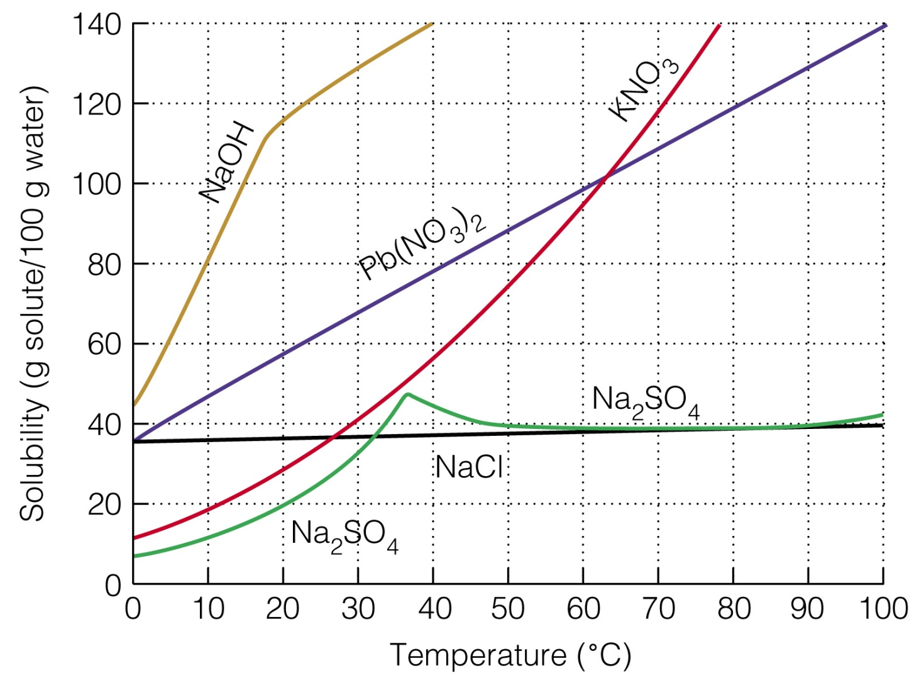
1) How many grams of sodium hydroxide (NaOH) will dissolve in 100 g of water at 15ºC?
(100 g)

Slide 23
2) How many grams of sodium hydroxide will dissolve in 100 g of water at 40ºC?
(140 g)

Slide 24
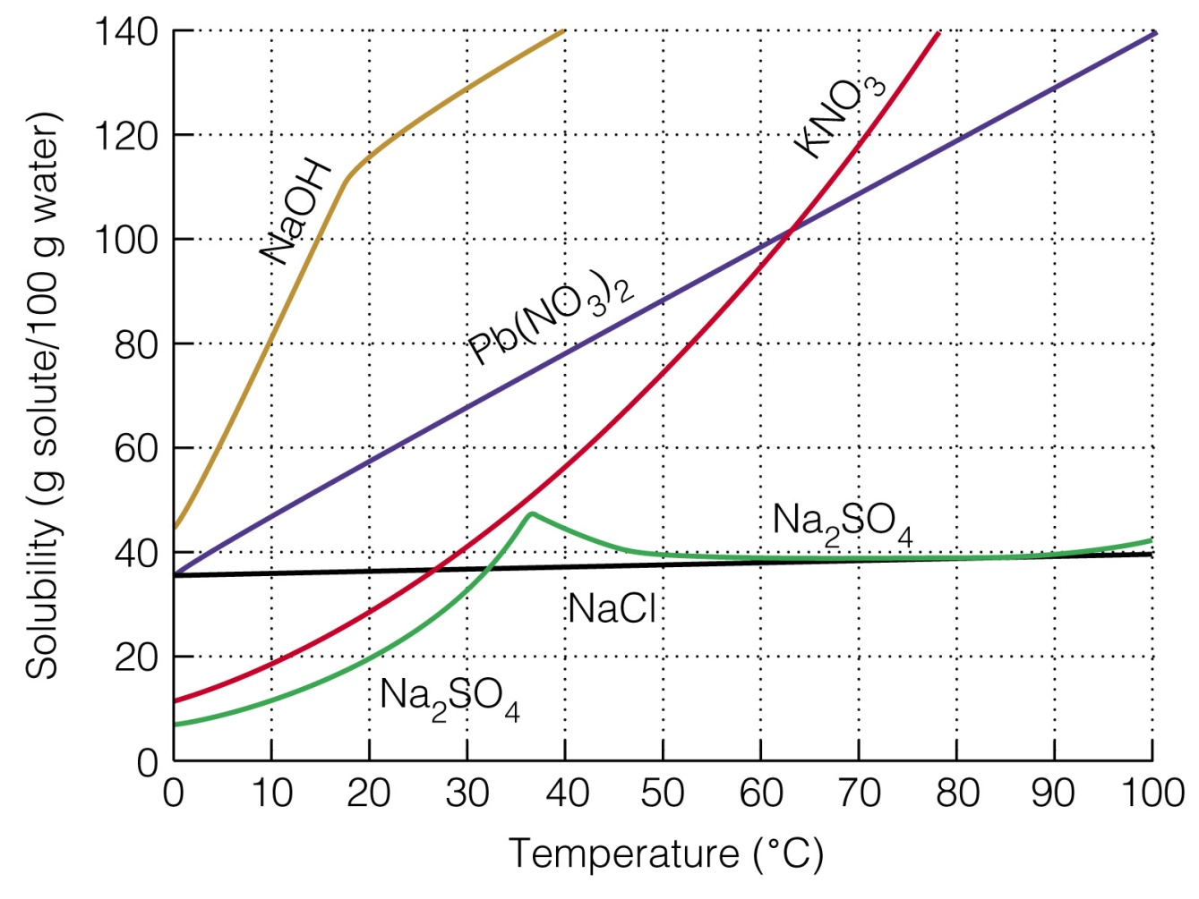
3) At what temperature will 90 grams of Pb(NO₃)₂ dissolve in 100 g of water?
(~50°C)

Slide 25
4) At what temperature will 30 grams of KNO₃ dissolve in 100 g of water?
(20°C)

Slide 26
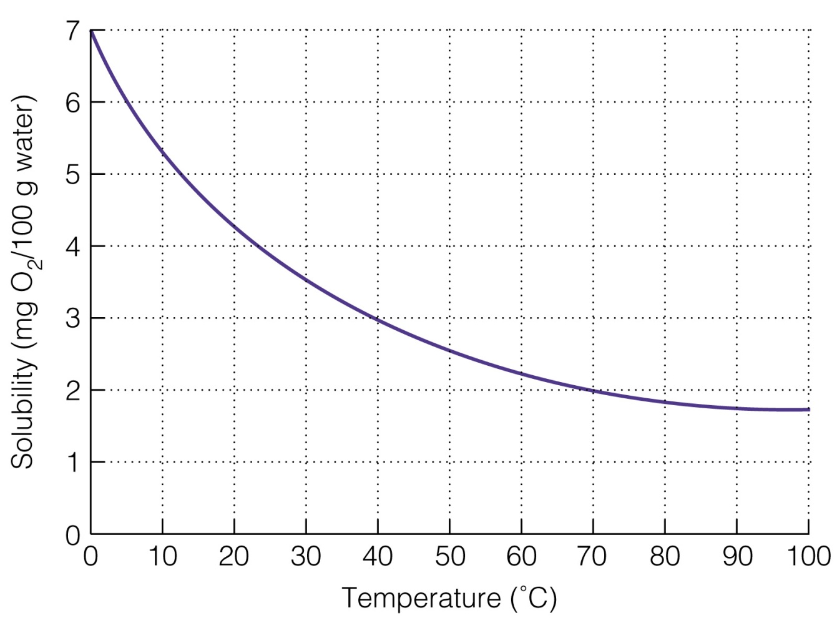
For gases in a liquid, as the temperature goes up the solubility goes down. Ex. Sodas at the gas station

Slide 27
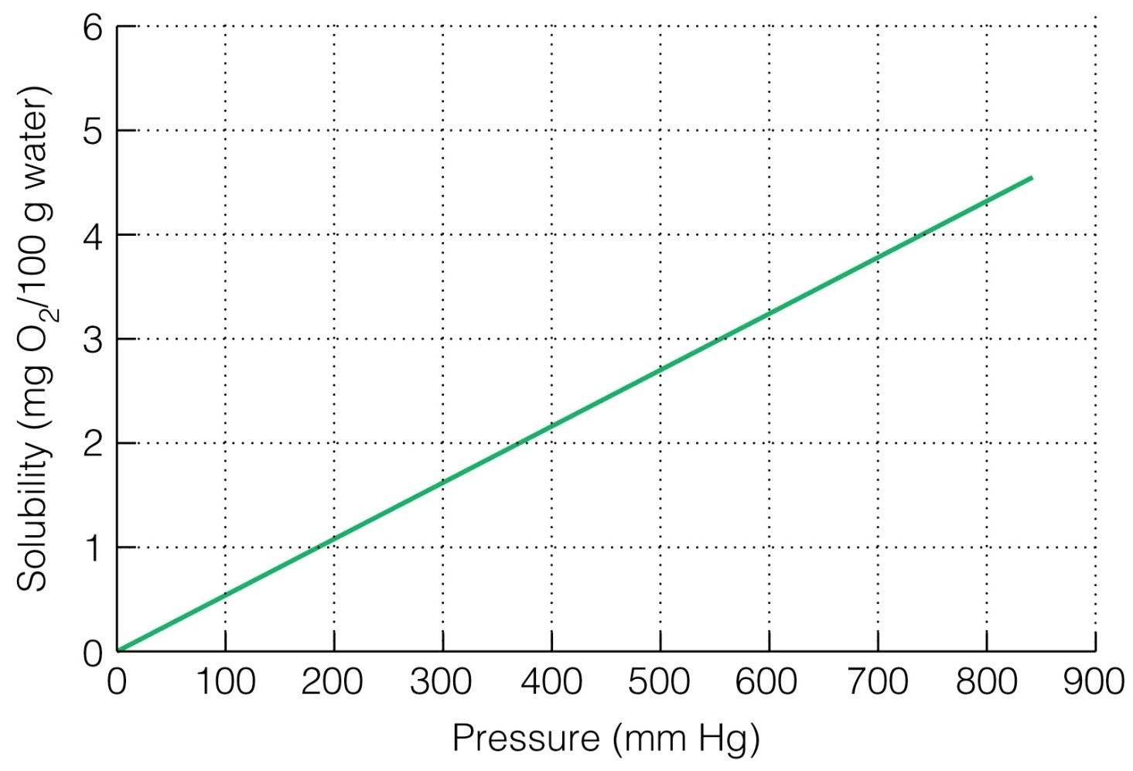
For gases in a liquid, as the pressure goes up the solubility goes up.

Slide 28
Colligative
Properties

Slide 29
Vapor Pressure Lowering
Vapor Pressure is the pressure exerted by a gas on a liquid (pressure caused by gas due to liquid evaporating)
The bonds between molecules keep molecules of a liquid from escaping into the vapor state.
In a solution, some of the solvent is busy keeping the solute dissolved.
This lowers the vapor pressure.

Slide 30
Vapor Pressure Lowering
The greater the number of ions, the more a salt will lower the vapor pressure.
NaCl → Na⁺ + Cl⁻ 2 ions
CaCl₂ → Ca⁺² + 2Cl⁻ 3 ions
Calcium chloride would lower the vapor pressure more because it dissociates into more ions.
Notes:
‹#›

Slide 31
Boiling Point Elevation
The vapor pressure determines the boiling point.
When vapor pressure is lower, the boiling point is higher.
It turns out that the boiling point of a solution is higher than the boiling point of the pure solvent.
Ex. Plain water vs. Salt Water

Slide 32
Boiling Point Elevation
Salt water boils above 100ºC.
KBr → K⁺ + Br⁻ 2 ions
MgF₂ → Mg⁺² + 2F⁻ 3 ions
Magnesium fluoride would raise the boiling point more because it dissociates into more ions.

Slide 33
Freezing Point Depression
Solids form when molecules make an orderly pattern.
The solute molecules, i.e. salt, break up the orderly pattern.
This makes the freezing point lower.
Ex. Salt on roads in Winter
Notes:
‹#›

Slide 34
Freezing Point Depression
Salt water freezes below 0ºC.
K₂SO₄ → 2K⁺ + SO₄⁻² 3 ions
NaCl → Na⁺¹ + Cl⁻ 2 ions
Potassium sulfate would lower the freezing point more because it dissociates into more ions.
Notes:
‹#›

Slide 35
Osmotic Pressure Increase
Osmotic pressure is the force with which a pure solvent moves across a semi-permeable barrier into a container that holds a solution
The bigger the difference in concentration (because of high solute concentration), the stronger the force of osmosis.

Slide 36
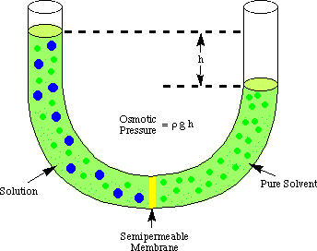
Osmotic Pressure Increase

Slide 37
Notes:
‹#›

Slide 38
Measuring Solutions

Slide 39
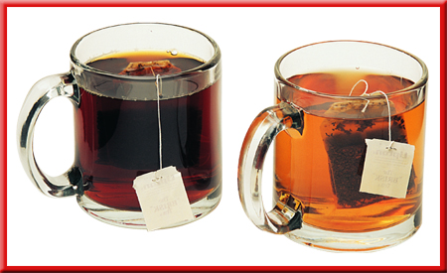
Concentration
Chemists never apply the terms strong and weak to solution concentrations.
Instead, use the terms concentrated and dilute.

Slide 40
Concentration
Concentration is a measure of the amount of solute dissolved in a certain amount of solvent.
A concentrated solution has a large amount of solute.
A dilute solution has a small amount of solute.
Notes:
‹#›

Slide 41
Molarity
For chemistry applications, the concentration term molarity is generally the most useful.
Molarity is the number of moles of solute in 1 Liter of the solution.
moles of solute
M =
liter of solution
Notes:
‹#›

Slide 42
Example
What is the molarity of a solution with 2.0 moles of NaCl in 4.0 Liters of solution?
2.0 mol
moles
M =
4.0 L
liters
M = 0.50 M

Slide 43
Problem
1) What is the molarity of a solution with 3.0 moles dissolved in 250 mL of solution?
3.0 mol
moles
M =
0.25 L
liters
M = 12 M

Slide 44
Problem
2) How many moles of NaCl are needed to make 6.0 L of a 0.75 M NaCl solution?
moles
0.75 M =
M =
6.0 L
liters
moles = 4.5 moles
Notes:
‹#›

Slide 45
Problem
3) 0.200 moles of NaOH are dissolved in a small amount of water then diluted to 500. mL. What is the concentration?
(0.400 M)
Notes:
‹#›

Slide 46
Problem
4) 1.25 moles of NaCl are dissolved in a small amount of water then diluted to 625 mL. What is the concentration?
(2.00 M)
Notes:
‹#›

Slide 47
Problem
5) How many moles are in 2.00 L of a 3.00 M solution of sulfuric acid (H₂SO₄)?
(6.00 mol)

Slide 48
Problem
6) How many moles are in 1500 mL of a 3.2 M solution of nitric acid (HNO₃)?
(4.8 mol)

Slide 49
Example
10.3 g of NaCl are dissolved in a small amount of water then diluted to 250 mL. What is the concentration?
NaCl
Sodium: 23.0 g
Chlorine: 35.5 g
58.5 g

Slide 50
Example, cont
10.3 g of NaCl are dissolved in a small amount of water then diluted to 250 mL. What is the concentration?
10.3 g
1 mol
= 0.176 mol
58.5 g

Slide 51
Example, cont.
10.3 g of NaCl are dissolved in a small amount of water then diluted to 250 mL. What is the concentration?
0.176 mol
moles
M =
0.25 L
liters
M = 0.70 M

Slide 52
Problem
7) 20.3 g of NaOH are dissolved in a small amount of water then diluted to 500. mL. What is the concentration?
(1.02 M)
Notes:
‹#›

Slide 53
Problem
8) 80.6 g of KCl are dissolved in a small amount of water then diluted to 500. mL. What is the concentration?
(2.16 M)

Slide 54
Problem
9) 125 g of NaC₂H₃O₂ are dissolved in a small amount of water then diluted to 750. mL. What is the concentration?
(2.03 M)
Notes:
‹#›

Slide 55
Example
How many grams of CaCl₂ are needed to make 625 mL of a 2.00 M solution?
moles
2.0 M =
M =
0.625 L
liters
moles = 1.25 moles

Slide 56
Example, cont.
How many grams of CaCl₂ are needed to make 625 mL of a 2.00 M solution?
1.25 mol
111.1 g
= 139 g
1 mol
139 g of calcium chloride is added to enough distilled water to make a total volume of 625 mL.
Notes:
‹#›

Slide 57
Problem
10) How many grams of sugar are needed to make 125 mL of a 0.500 M C₆H₁₂O₆ solution?
(11.3 g)
Notes:
‹#›

Slide 58
Problem
11) How many grams of sodium hydroxide are needed to make 500. mL of a 0.750 M NaOH solution?
(15.0 g)
Notes:
‹#›

Slide 59
Problem
12) How many grams of aluminum nitrate are needed to make 600. mL of a 0.500 M Al(NO₃)₂ solution?
(45.3 g)
Notes:
‹#›

Slide 60
Notes:
‹#›

Slide 61
Dilution
Adding Water to a Solution
Notes:
‹#›

Slide 62
Dilution
The number of moles of solute doesn’t change if you add more solvent.
M₁ x V₁ = M₂ x V₂
M₁ and V₁ represent the starting concentration and volume.
M₂ and V₂ represent the final concentration and volume.
Notes:
‹#›

Slide 63
Example
2.0 L of a 0.88 M solution are diluted to 3.8 L. What is the new molarity?
0.88
M₁
=
(2.0)
V₁
M₂
3.8
V₂
M₂ = 0.46 M
Notes:
‹#›

Slide 64
Problem
13) 6.0 L of a 0.55 M solution are diluted to 8.8 L. What is the new molarity?
(M₂ = 0.38 M)

Slide 65
Problem
14) You have 150 mL of 6.0 M HCl. What volume of 1.3 M HCl can you make?
6.0
M₁
(150)
=
V₁
M₂
1.3
V₂
V₂ = 692 mL
Notes:
‹#›

Slide 66
Problem
15) 6.0 liters of a 0.55 M solution are diluted to a 0.35 M solution. What is the final volume?
(V₂ = 9.4 L)
Notes:
‹#›

Slide 67
Problem
16) You need 450 mL of 0.15 M NaOH. All you have available is a 2.0 M stock solution of NaOH. How do you make the required solution?
0.15
M₁
(450)
=
V₁
M₂
2.0
V₂
V₂ = 34 mL
Notes:
‹#›

Slide 68
Problem
You need 450 mL of 0.15 M NaOH. All you have available is a 2.0 M stock solution of NaOH. How do you make the required solution?
You should take 34 mL of the 2.0 M NaOH and add (450 – 34) mL = 416 mL of distilled water to the solution.

Slide 69
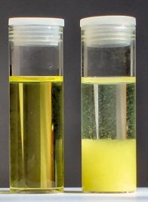
How Much Solute?
Solubility is the maximum amount of substance that will dissolve at that temperature (usually measured in grams/liter).

Slide 70
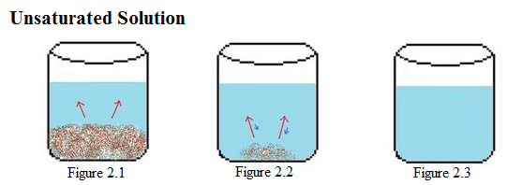
How Much Solute?
If the amount of solute dissolved is less than the maximum that could be dissolved, the solution is called an unsaturated solution.

Slide 71
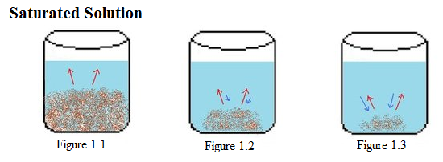
How Much Solute?
A solution which holds the maximum amount of solute per amount of the solution under the given conditions is called a saturated solution.

Slide 72
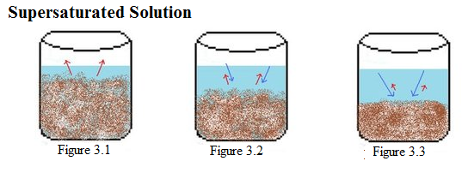
How Much Solute?
A supersaturated solution contains more solute than the usual maximum amount and is unstable.

Slide 73
How Much Solute?
A supersaturated solution cannot permanently hold the excess solute in solution and may release it suddenly.
A seed crystal will make the extra come out.

Slide 74
How Much?
Generally, a supersaturated solution is formed by dissolving a solute in the solution at an elevated temperature, at which solubility is higher than at room temperature, and then slowly cooling the solution.

Slide 75
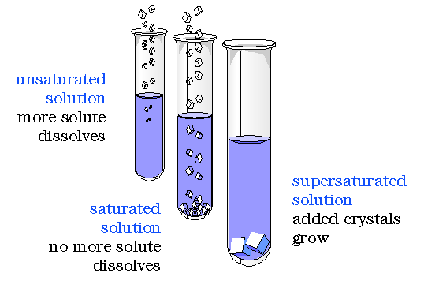
Degree of Saturation

Slide 76
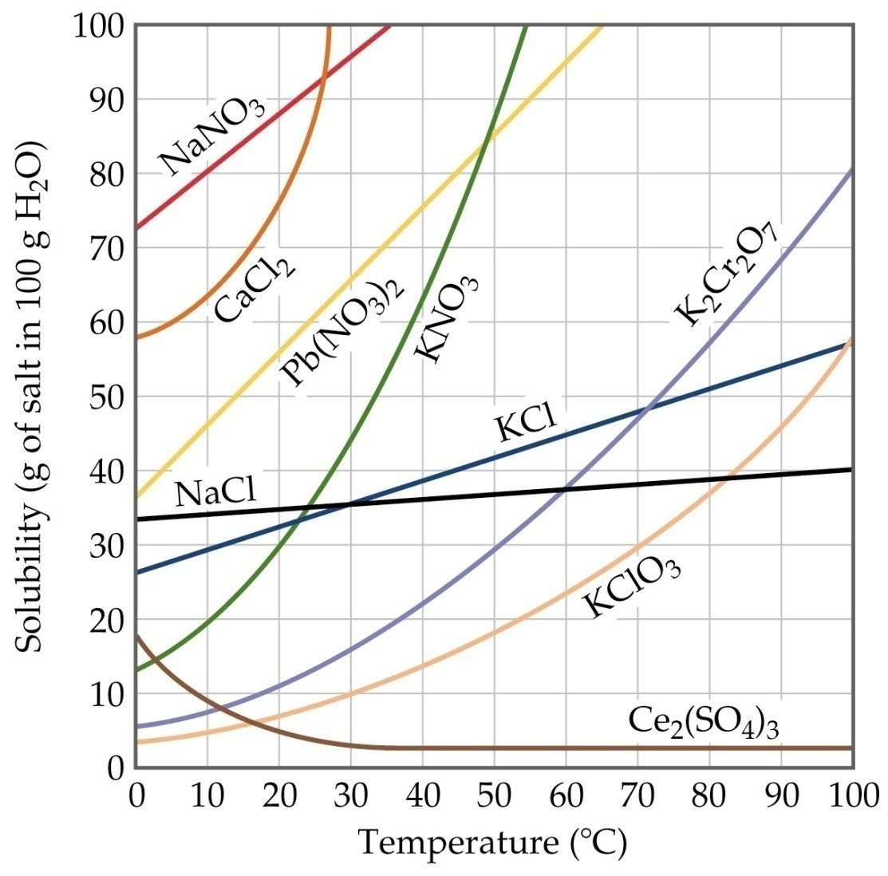
a) If 45 g of KCl is dissolved in 100 g of water at 60ºC, is the solution unsaturated, saturated or supersaturated?
(saturated)

Slide 77
b) If 90 g of Pb(NO₃)₂ is dissolved in 100 g of water at 40ºC, is the solution unsaturated, saturated or supersaturated?
(supersaturated)

Slide 78
c) If 30 g of KNO₃ is dissolved in 100 g of water at 20ºC, is the solution unsaturated, saturated or supersaturated?
(saturated)

Slide 79
d) If 10 g of KClO₃ is dissolved in 100 g of water at 50ºC, is the solution unsaturated, saturated or supersaturated?
(unsaturated)

Slide 80
Compounds in Aqueous Solution
The separation of ions when an ionic compound dissolves in water is called dissociation.
Although no compound is completely insoluble, compounds of very low solubility can be considered insoluble.

Slide 81
Compounds in Aqueous Solution
Using the solubility rules printed on page 6 of the NCDPI Reference Tables for Chemistry, determine whether the following salts are soluble in water.
a) sodium chloride
(soluble)

Slide 82
Compounds in Aqueous Solution
b) mercury (I) acetate
(soluble)
c) potassium nitrate
(soluble)

Slide 83
Compounds in Aqueous Solution
d) nickel carbonate
(insoluble)
e) barium sulfate
(insoluble)

Slide 84
Compounds in Aqueous Solution
f) ammonium bromide
(soluble)
g) calcium sulfide
(soluble)

Slide 85
Double Replacement Reactions
In a double-replacement reaction, two compounds exchange partners with each other to produce two different compounds. The general form of the equation is
AB + CD → AD + CB

Slide 86
Double Replacement Reactions
Signs that a double-replacement reaction has taken place include a color change, the release or absorption of energy, evolution of a gas, and formation of a precipitate (which is a solid that will not dissolve in water).

Slide 87
Net Ionic Equations
In molecular equations, the formulas of the compounds are written as though all species existed as molecules or whole units.

Slide 88
Net Ionic Equations
An ionic equation shows dissolved ionic compounds in terms of their free ions.

Slide 89
Net Ionic Equations
Ions that are not involved in the overall reaction are called spectator ions.
The net ionic equation indicates only the species that actually take part in the reaction.

Slide 90
Net Ionic Equations
The following steps are useful for
writing ionic and net ionic equations:
1) Write a balanced molecular equation for the reaction.

Slide 91
Net Ionic Equations
Rewrite the equation to indicate which substances are in ionic form in solution. Remember that all soluble salts (and other strong electrolytes), are completely dissociated into cations and anions. This procedure gives us the ionic equation.

Slide 92
Net Ionic Equations
Lastly, identify and cancel spectator ions on both sides of the equation to arrive at the net ionic equation.

Slide 93
Molecular equation:
3NaOH + FeCl₃ → Fe(OH)₃ + 3NaCl
Complete ionic equation:
3Na⁺ + 3OH⁻ + Fe³⁺ + 3Cl⁻ →
Fe(OH)₃ + 3Na⁺ + 3Cl⁻
Net ionic equation:
3OH⁻ (aq) + Fe³⁺ (aq) → Fe(OH)₃ (s)

Slide 94
Example
Identify the spectator ions and the precipitate and write the balanced net ionic equation.
(NH₄)₂SO₄ + BaF₂ → _______________
The products are BaSO₄ and NH₄F. Which product is insoluble?

Slide 95
Example
Identify the spectator ions and the precipitate and write the balanced net ionic equation.
(NH₄)₂SO₄ + BaF₂ → _______________
BaSO₄ is the precipitate.
NH₄⁺ and F⁻ are the spectator ions.
Ba²⁺ + SO₄²⁻ → BaSO₄

Slide 96
Double Replacement Reactions
Identify the spectator ions and the precipitate and write the balanced net ionic equation.
a) BaCl₂+ AgNO₃ →
AgCl is the precipitate.
Ba²⁺ and NO₃⁻ are spectator ions.
Ag⁺ + Cl⁻ → AgCl

Slide 97
Double Replacement Reactions
b) Pb(NO₃)₂ + KI →
PbI₂ is the precipitate.
NO₃⁻ and K⁺ are the spectator ions.
Pb²⁺ + 2 I⁻ → PbI₂

Slide 98
Double Replacement Reactions
c) (NH₄)₂SO₄+ Ba(NO₃)₂ →
BaSO₄ is the precipitate.
NH₄⁺ and NO₃⁻ are the spectator ions.
Ba²⁺ + SO₄²⁻ → BaSO₄

Slide 99
Double Replacement Reactions
d) K₂S+ Zn(C₂H₃O₂)₂ →
ZnS is the precipitate.
K⁺ and C₂H₃O₂⁻ are the spectator ions.
Zn²⁺ + S²⁻ → ZnS

Slide 100
Double Replacement Reactions
e) Sr₃(PO₄)₂+ Al(OH)₃ →
AlPO₄ is the precipitate.
Sr²⁺ and OH⁻ are the spectator ions.
Al³⁺ + PO₄³⁻ → AlPO₄

