Slide 1
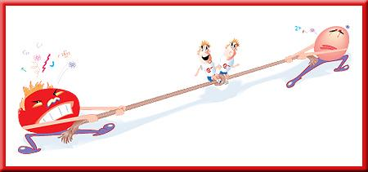
POLARITY

Slide 2
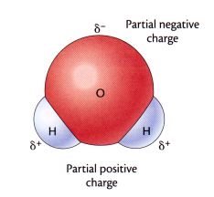
Polar Molecules
A polar molecule is a molecule with one end having positive electrical charge and the other end having negative electrical charge.
Notes:
‹#›

Slide 3
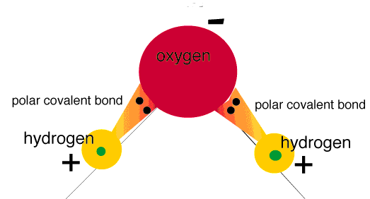
Polar Molecules
This requires two things to be true:
The molecule must contain polar bonds.

Slide 4
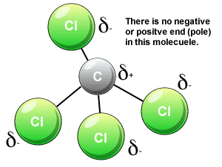
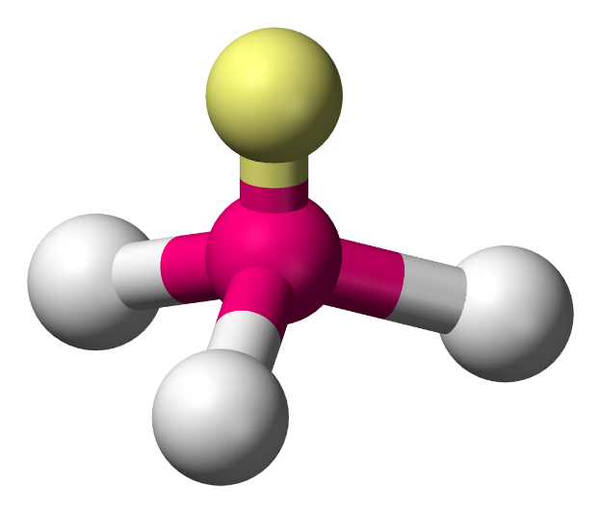
Polar Molecules
Symmetry cannot cancel out the effects of the polar bonds.
. .
H
N
H
H
nonpolar
polar

Slide 5
Example
1) Is hydrogen fluoride (HF) polar?
H – F
YES, fluorine has a higher electronegativity than hydrogen.

Slide 6
Example
2) Is water (H₂O) polar?
H – O – H
YES. The lone pair electrons around the central element makes water polar.

Slide 7
Example
3) Is carbon tetrachloride (CCl₄) polar?
Cl
Cl – C – Cl
Cl
NO. There are no lone pair electrons around the central element, and the same element is pulling on carbon in all directions.

Slide 8
Example
4) Is trichloromethane (CHCl₃) polar?
Cl
H – C – Cl
Cl
YES. Different elements are pulling on carbon.

Slide 9
Problem
5) Is ammonia (NH₃) polar?
H – N – H
H
YES. The lone pair electrons around the central element results in ammonia being polar.

Slide 10
Problem
6) Is carbon dioxide (CO₂) polar?
O C O
NO. There are no lone pair of electrons around the central element, and the same element is pulling on carbon in all directions.

Slide 11
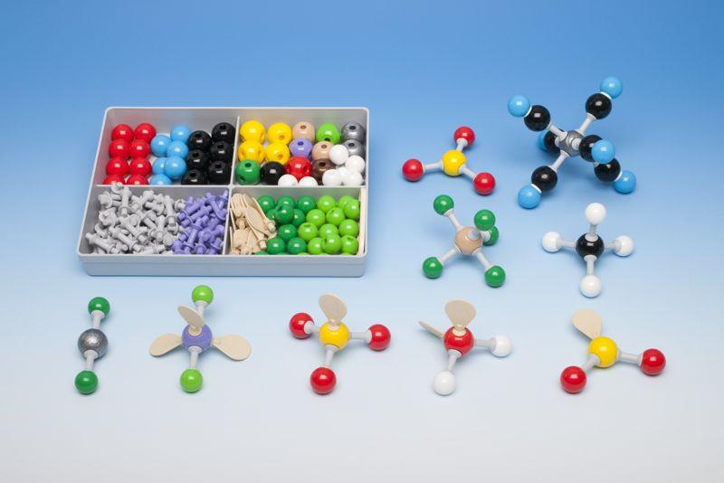
VSEPR

Slide 12
VSEPR
VSEPR stands for Valence Shell Electron Pair Repulsion.
It predicts the three-dimensional geometry of molecules.
The valence shell includes the outermost electrons.

Slide 13
VSEPR
The electron pairs try to get as far away as possible to minimize repulsion.
VSEPR is based on the number of pairs of valence electrons, both bonded and non-bonded.
An non-bonded pair of electrons is referred to as a lone pair.

Slide 14
VSEPR
Use the Wetter Way to calculate the number of bonds and then draw the dot-dash diagram. The shape of the molecule, bond angle and polarity can be determined from this diagram.

Slide 15
LINEAR
Perform the Wetter Way for H₂. How many bonds are in this molecule?

Slide 16
LINEAR
H is in column 1A and therefore has ___ valence electron(s) before bonding.
Hydrogen has ____ electrons after bonding.
1
2

Slide 17
LINEAR
after
__ x 2 =
2
4
H₂
__ x 2 =
before
1
2

Slide 18
The Wetter Way
Σe- after – Σe- before
# bonds =
2
4 – 2
= 1
# bonds =
2
H₂ has 1 bond!

Slide 19
LINEAR
Sketch the dot-dash diagram for H₂. Please include all electrons.

Slide 20
LINEAR
Connect the elements with a single bond.
H
H
You have used all of the calculated bonds.

Slide 21
LINEAR
Each hydrogen has 1 line attached which represents 2 electrons. No extra electrons are needed around hydrogen to have the 2 electrons needed after bonding.
H
H

Slide 22
LINEAR
A hydrogen molecule is linear.
180°
H
H
The electrons attempt to maximize their distance from one another by having bond angle of 180°.

Slide 23
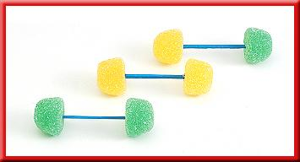
LINEAR
Linear compounds are NOT polar, unless the two elements are different.

Slide 24
LINEAR
The hydrogen molecule is (polar or nonpolar).
H
H
nonpolar

Slide 25
TRIGONAL PLANAR
Perform the Wetter Way for H₂CO. How many bonds are in this molecule?
4

Slide 26
TRIGONAL PLANAR
Sketch the dot-dash diagram for H₂CO. Please include all electrons. (Carbon is the central atom.)
H
C
O
H

Slide 27
TRIGONAL PLANAR
The farthest you can get the three elements apart is 120º.
The shape is flat and called trigonal planar.
H
120º
C
H
O

Slide 28
TRIGONAL PLANAR
The H₂CO molecule is (polar or nonpolar).
H
C
H
O
polar

Slide 29
BENT
Perform the Wetter Way for SO₂. How many bonds are in this molecule?
3

Slide 30
BENT
Sketch the dot-dash diagram for SO₂. Please include all electrons.
O
S
O

Slide 31
BENT
The electron pair forces the oxygen’s closer together so the angle is less than 120º.
The shape is flat and called bent.
S
O
O
<120º

Slide 32
BENT
The SO₂ molecule is (polar or nonpolar).
O
S
O
polar

Slide 33
TETRAHEDRAL
Perform the Wetter Way for CH₄. How many bonds are in this molecule?
4

Slide 34
TETRAHEDRAL
Sketch the dot-dash diagram for CH₄. Please include all electrons.
H
H
C
H
H

Slide 35
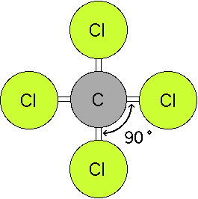
TETRAHEDRAL
If all of the hydrogen’s were in the same plane they would be 90 apart.

Slide 36
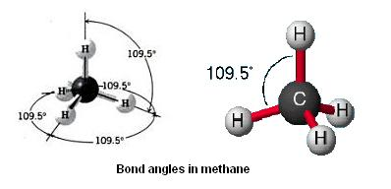
TETRAHEDRAL
The bonding electrons can maximize their distance from one another by forming a 3-D shape.
The furthest they can get away is 109.5º.

Slide 37
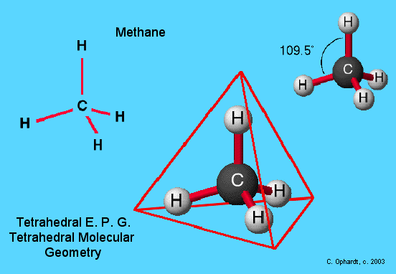
TETRAHEDRAL
This basic shape is a tetrahedral, a pyramid with a triangular base.

Slide 38
TETRAHEDRAL
The CH₄ molecule is (polar or nonpolar).
H
H
C
H
H
nonpolar

Slide 39
TRIGONAL PYRAMIDAL
Perform the Wetter Way for phosphorous trichloride (PCl₃). How many bonds are in this molecule?
3

Slide 40
TRIGONAL PYRAMIDAL
Sketch the dot-dash diagram for phosphorous trichloride (PCl₃). Please include all electrons.
Cl
P
Cl
Cl

Slide 41
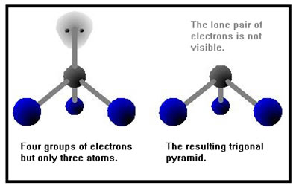
TRIGONAL PYRAMIDAL
The shape is a basic tetrahedral but you can’t see the lone pair.

Slide 42
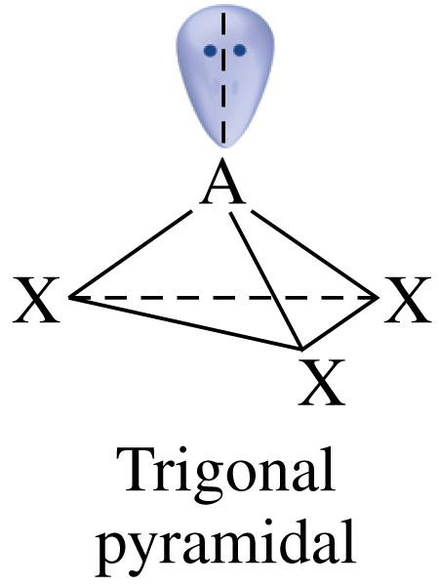
TRIGONAL PYRAMIDAL
A tetrahedral-like shape that has 3 attached elements and one lone pair is called trigonal pyramidal.

Slide 43
TRIGONAL PYRAMIDAL
The bond angle is less than 109.5° between the chlorines because the electron pair forces the chlorine’s closer to each other.
P
Cl
Cl
Cl
107º

Slide 44
TRIGONAL PYRAMIDAL
The PCl₃ molecule is (polar or nonpolar).
Cl
P
Cl
Cl
polar

Slide 45
BENT
Perform the Wetter Way for water (H₂O). How many bonds are in this molecule?
2

Slide 46
BENT
Sketch the dot-dash diagram for water (H₂O). Please include all electrons.
H
O
H

Slide 47
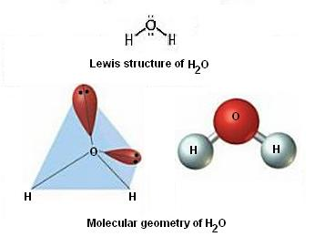
BENT
The shape is still a basic tetrahedral but you can’t see the 2 lone pairs.

Slide 48
BENT
A tetrahedral-like shape that has 2 attached elements and 2 lone pairs is called bent.

Slide 49
BENT
The two electron pairs force the hydrogen’s even closer to each other.
The bond angle between hydrogen’s is 104.5°.
O
H
H
104.5º

Slide 50
BENT
The H₂O molecule is (polar or nonpolar).
H
O
H
polar

Slide 51
Problem
7) Determine the number of bonds, draw the dot-dash diagram, state the VSEPR shape, provide the bond angle, and determine the polarity for CO₂.
180º
O
C
O
Linear, nonpolar

Slide 52
Problem
8) Determine the number of bonds, draw the dot-dash diagram, state the VSEPR shape, provide the bond angle, and determine the polarity for BCl₃.
120º
Cl
Cl
B
Trigonal planar, nonpolar
Cl

Slide 53
Problem
9) Determine the number of bonds, draw the dot-dash diagram, state the VSEPR shape, provide the bond angle, and determine the polarity for SCl₂.
Cl
104.5º
S
Bent, polar
Cl

Slide 54
Problem
10) Determine the number of bonds, draw the dot-dash diagram, state the VSEPR shape, provide the bond angle, and determine the polarity for SiF₄.
F
109.5º
Si
Tetrahedral, nonpolar
F
F
F

Slide 55
Like Dissolves Like
Although water dissolves an enormous variety of substances, both ionic and covalent, it does not dissolve everything.
The phrase that scientists often use when predicting solubility is “like dissolves like.”

Slide 56
Like Dissolves Like
Polar substances will dissolve in other substances that are polar.
Nonpolar substances dissolve in other nonpolar substances.

