Slide 1
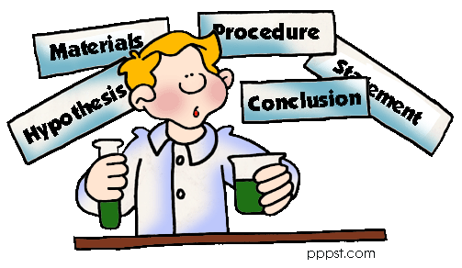
The Scientific Method

Slide 2
What is the Scientific Method?
The steps that scientists take when conducting a VALID experiment.
There is a distinct order!
If the steps are not followed, the results are NOT scientifically VALID!!

Slide 3
The Steps to the Scientific Method
1. State the problem
2. Gather information
3. Formulate a hypothesis
4. Conduct your experiment
5. Record and Analyze Data
6. State your conclusion

Slide 4
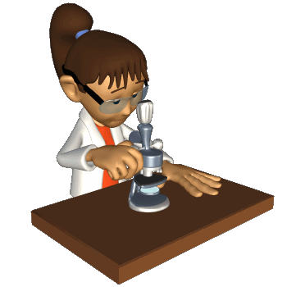
State Your Problem
You can’t solve a problem if you don’t know what it is!
If your plants are dying and you want to figure out why…this is your problem
Why are my plants dying?
This is ALWAYS the
first step in science!!

Slide 5
Gather Information
What do you know about your problem?
Make sure to use reliable sources
Wikipedia is NOT a reliable source!
ANYONE can make a .com site
Better sources are .gov and .edu sites
Best to use MULTIPLE sources, for confirmation of information!

Slide 6
Plant Situation
Plants need 4 basic things to survive
Water
Sunlight
Proper temperature
Good soil

Slide 7
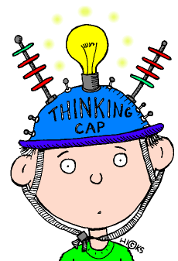
NY vs. NC
Rainfall levels – similar
Sunlight – similar
Temperature – similar
Soil – DIFFERENT
NY – topsoil
NC – clay
Could the soil be
causing the problem?

Slide 8
Formulate Your Hypothesis
Hypothesis – a prediction based on previous knowledge and research.
NOT an ‘educated guess’!!
MUST be TESTABLE!!
The North Carolina clay is
what is killing my plant.

Slide 9
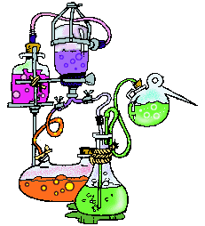
Conduct Your Experiment
Must be a CONTROLLED experiment
means you can only have ONE variable in the experiment
Variable – the thing that you change in the experiment to see its effect on the outcome.
Independent variable – the thing YOU CONTROL (soil type)
Dependent variable – the outcome

Slide 10
VALID or INVALID?
Does water level affect plant growth?
Experimental set up
4 plants (all the same)
Plant 1 – 1 cup water/daily
Plant 2 – 2 cups water/daily
Plant 3 – 3 cups water/daily
Plant 4 – 4 cups water daily
Same amounts of sunlight
Same type of soil
Same temperature
What is the variable?
Amount of Water

Slide 11
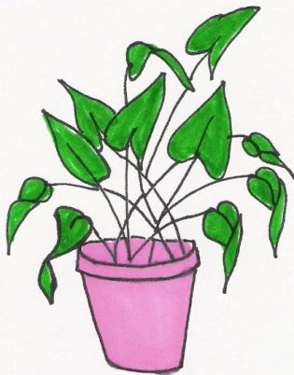
Experimental Set Up 1
Plant 1 Plant 2 Plant 3 Plant 4
1 cup H2O 2 cups H2O 3 cups H2O 4 cups H2O

Slide 12
If after 4 weeks plant 4 grew the tallest, can we say it was because it received the most water?
YES!! Why?
Because the amount of water was the ONLY THING DIFFERENT in the experiment!
Experiment had only 1 variable!!
This is a VALID experiment!!

Slide 13
VALID or INVALID?
Experimental set up
4 plants (different types)
Plant 1 – 1 cup water/daily
Plant 2 – 2 cups water/daily
Plant 3 – 3 cups water/daily
Plant 4 – 4 cups water daily
Same amounts of sunlight
Same type of soil
Same temperature

Slide 14
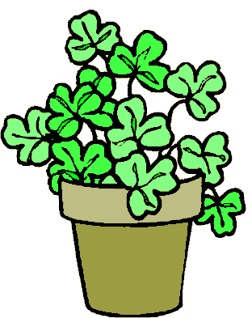
Experimental Set Up 2
Plant 1 Plant 2 Plant 3 Plant 4
1 cup H2O 2 cups H2O 3 cups H2O 4 cups H2O

Slide 15
If after 4 weeks plant 4 grew the tallest, can we say it was because it received the most water?
NO!! Why?
Because the amount of water was NOT the only thing different in the experiment!
The experiment had MORE THAN ONE variable!
This is a INVALID experiment!!

Slide 16
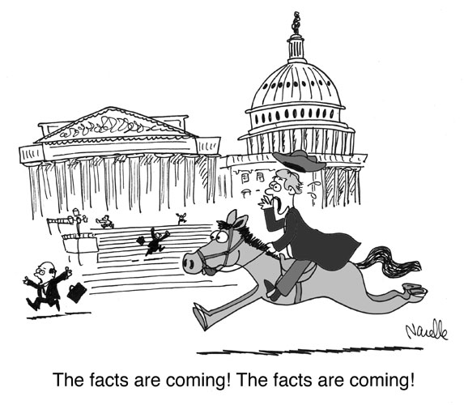
Record and Analyze Your Data
Two kinds of data
QUANTITATIVE – based on NUMBER
ex. – the plant grew 3 inches
QUALITATIVE – based on QUALITY
ex. – the plant was green and healthy
The best conclusions contain
BOTH types of data

Slide 17
State Your Conclusion
Hypotheses are NEVER right or wrong!
They are either SUPPORTED by your data or NOT SUPPORTED by your data
Science is NEVER Wrong!!

Slide 18
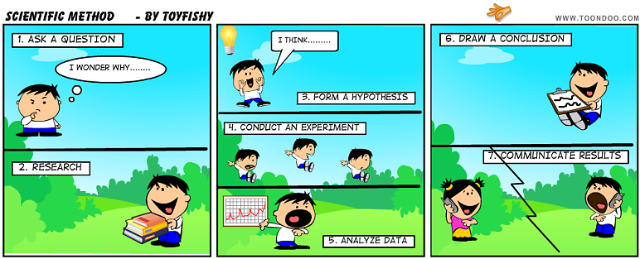
Hypothesis NOT SUPPORTED?
What do you do?
REVISE your hypothesis and try again

Slide 19
Hypothesis SUPPORTED?
What do you do?
Are you finished?
NO
Repeat!! Repeat!! Repeat!!
Why?
Reliability

Slide 20
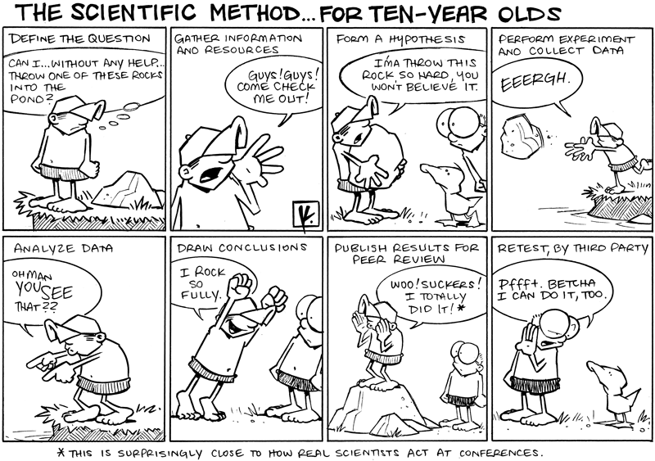

Slide 21
State the Problem
The
Scientific
Method
Gather Information
Form a Hypothesis
Conduct Experiment
Revise Hypothesis
and Try Again
REPEAT!!
REPEAT!!
Analyze Data
Draw Conclusion
Hypothesis NOT
supported
Hypothesis
supported

Slide 22
Control Group – the group you leave alone,
the group that functions normally
Experimental Group – The group that is changed in some way
Independent Variable – The thing that you change in the experiment. The thing that YOU control
Dependent Variable – The results of the experiment

Slide 23
Two groups of people were tested to see if their reaction time was slowed down when texting while driving. Two sets of people drove the same road course. Group A were not allowed to have phones in the car with them while completing the drive (this is the normal condition). Group B was allowed to text while driving through the course. The time it took for both groups to react to stop lights and stop signs was recorded to see if texting distractions made them react slower.
Who was the CONTROL group?
Who was the EXPERIMENTAL group?
What is the INDEPENDENT variable?
What is the DEPENDENT variable?
Group A
Group B
Phone or no phone
Reaction time

