Slide 1
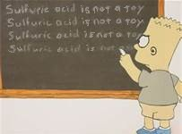
Acids and Bases
Part 1

Slide 2
Properties of Acids
Acids taste sour.
Lemon juice and vinegar, for example, are both aqueous solutions of acids.
Acids conduct electricity; they are electrolytes.
Some are strong electrolytes, while others are weak electrolytes.
Notes:
‹#›

Slide 3
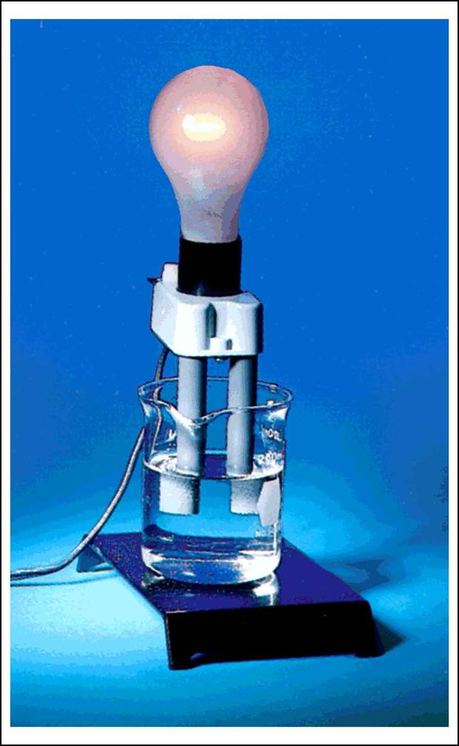
An acetic acid solution, which is a weak electrolyte, contains only a few ions and does not conduct as much current as a strong electrolyte. The bulb is only dimly lit.

Slide 4
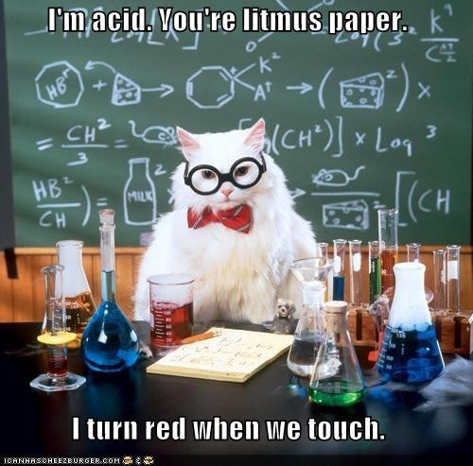
Properties of Acids
Acids cause certain colored dyes (indicators) to change color. (Litmus paper turns red.)
Notes:
‹#›

Slide 5
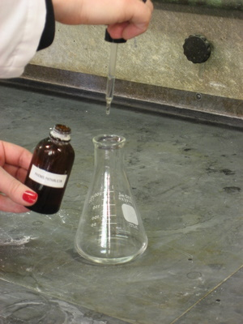
Properties of Acids
Acids cause the indicator phenolphthalein to remain colorless.
Notes:
‹#›

Slide 6
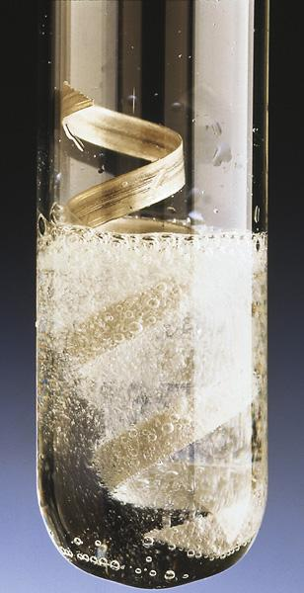
Properties of Acids
Acids react with metals to form hydrogen gas. This property explains why acids corrode most metals.
Example: 2HBrO₃ + Zn → Zn(BrO₃)₂ + H₂

Slide 7
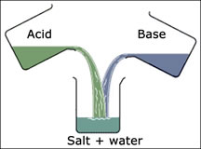
Properties of Acids
Acids react with hydroxides (bases) to form water and a salt.
Example: 2HNO₃ + Ba(OH)₂ → Ba(NO₃)₂ + 2H₂O

Slide 8
Properties of Acids

Slide 9
Properties of Bases
Taste bitter.
Feel slippery.
Bases can be strong or weak electrolytes.

Slide 10
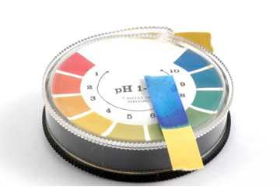
Properties of Bases
Bases cause certain colored dyes (indicators) to change color. (Litmus paper turns blue).

Slide 11
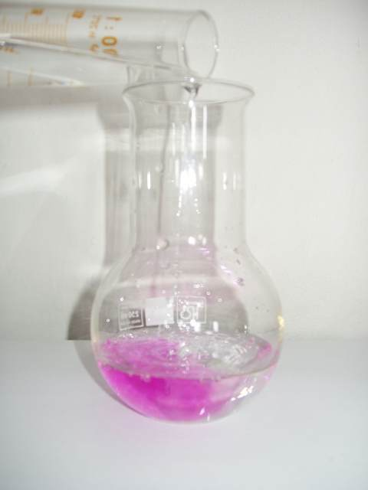
Properties of Bases
Bases cause the indicator phenolphthalein to turn pink.
Notes:
‹#›

Slide 12
Properties of Bases
Bases react with acids to form water and a salt.
Bases do not commonly react with metals.

Slide 13
Naming Acids
Notes:
‹#›

Slide 14
Acids
Acids are compounds that give off hydrogen ions (H⁺) when dissolved in water.
Acids will always contain one or more hydrogen ions next to an anion.
The anion determines the name of the acid.
Notes:
‹#›

Slide 15
Naming Binary Acids
Binary acids contain hydrogen and an anion whose name ends in –ide.
When naming the acid, put the prefix hydro- and change -ide to -ic acid.

Slide 16
Example
HCl
The acid contains the hydrogen ion and chloride ion.
Begin with the prefix hydro-, name the nonmetallic ion and change -ide to -ic acid.
hydro
chlor
ide
ic acid
Notes:
‹#›

Slide 17
Example
H₂S
The acid contains the hydrogen ion and sulfide ion.
Begin with the prefix hydro- and name the nonmetallic ion.
hydro
sulf
ide
Notes:
‹#›

Slide 18
Example
H₂S
The next step is change -ide to -ic acid, but for sulfur the “ur” is added before -ic.
hydro
sulf
ide
ur
ic acid

Slide 19
Problem
1. Name the following binary acids.
a) HF
(hydrofluoric acid)
b) H₃P
(hydrophosphoric acid)

Slide 20
Writing the Formulas for Binary Acids
The prefix hydro- lets you know the acid is binary.
Determine whether you need to criss-cross the oxidation numbers of hydrogen and the nonmetal.

Slide 21
Example
Hydrobromic acid
The acid contains the hydrogen ion and the bromide ion.

Slide 22
Example
Hydrobromic acid
H¹⁺Br¹⁻
The two oxidation numbers add together to get zero.
HBr

Slide 23
Example
Hydrotelluric acid
The prefix hydro- lets you know the acid is binary.
The acid contains the hydrogen ion and the telluride ion.

Slide 24
Example
Hydrotelluric acid
H¹⁺Te²⁻
The two oxidation numbers do NOT add together to get zero, so you must criss-cross.
H₂Te

Slide 25
Problem
2) Write the formulas for the following binary acids.
a) Hydrocyanic acid
HCN
b) Hydroselenic acid
H₂Se

Slide 26
Naming Ternary Acids
The acid is a ternary acid if the anion has oxygen in it.
The anion ends in -ate or -ite.
Change the suffix -ate to -ic acid
Change the suffix -ite to -ous acid
The hydro- prefix is NOT used!

Slide 27
Example
HNO₃
The acid contains the hydrogen ion and nitrate ion.
Name the polyatomic ion and change -ate to -ic acid.
nitr
ate
ic acid

Slide 28
Example
HNO₂
The acid contains the hydrogen ion and nitrite ion.
Name the polyatomic ion and change -ite to -ous acid.
nitr
ite
ous acid

Slide 29
Example
H₃PO₄
The acid contains the hydrogen ion and phosphate ion.
Name the polyatomic ion and change -ate to -ic acid.
phosph
ate
oric acid

Slide 30
Problem
3) Name the following ternary acids.
a) H₂CO₃
(carbonic acid)
b) H₂SO₄
(sulfuric acid)

Slide 31
Problem
Name the following ternary acids.
c) H₂CrO₄
(chromic acid)
d) HClO₂
(chlorous acid)
Notes:
‹#›

Slide 32
Writing the Formulas for Ternary Acids
The lack of the prefix hydro- from the name implies the acid is ternary, made of the hydrogen ion and a polyatomic ion.
Determine whether you need to criss-cross the oxidation numbers of hydrogen and the polyatomic ion.
Notes:
‹#›

Slide 33
Example
Acetic acid
The polyatomic ion must end in –ate since the acid ends in -ic.
The acid is made of H⁺ and the acetate ion.
H¹⁺C₂H₃O₂¹⁻

Slide 34
Example
H¹⁺C₂H₃O₂¹⁻
The two charges when added equal zero.
HC₂H₃O₂
Notes:
‹#›

Slide 35
Example
Sulfurous acid
Again the lack of the prefix hydro- implies the acid is ternary, made of the hydrogen ion and a polyatomic ion.
Notes:
‹#›

Slide 36
Example
sulfurous acid
The polyatomic ion must end in –ite since the acid ends in -ous.
The acid is made of H⁺ and the sulfite ion.
H¹⁺SO₃²⁻
Notes:
‹#›

Slide 37
Example
H¹⁺SO₃²⁻
The two charges when added do not equal zero, so you must crisscross the oxidation numbers.

Slide 38
Example
H¹⁺SO₃²⁻
Ignore the negative sign and ones are understood.
H₂SO₃
Notes:
‹#›

Slide 39
Problem
4) Write the formulas for the following ternary acids.
a) perchloric acid
HClO₄
b) iodic acid
HIO₃
Notes:
‹#›

Slide 40
Problem
Write the formulas for the following ternary acids.
c) nitrous acid
HNO₂
d) bromic acid
HBrO₃
Notes:
‹#›

Slide 41
Types of Acids and Bases
Notes:
‹#›

Slide 42
Arrhenius Definition
The simplest definition is that an acid is a substance that produces hydronium ions when it dissolves in water.
A hydronium ion, H₃O⁺, consists of a hydrogen ion attached to a water molecule.

Slide 43
Arrhenius Definitions
A hydronium ion, H₃O⁺, is equivalent to H⁺.
HCl and H₃PO₄ are acids according to Arrhenius.

Slide 44
Arrhenius Definitions
A base is a substance that produces hydroxide ions, OH–, when it dissolves in water.
Ca(OH)₂ and NaOH are Arrhenius bases.
NH₃, ammonia, could not be an Arrhenius base.

Slide 45
Monoprotic Acids
Monoprotic acids have only one ionizable hydrogen.
Notes:
‹#›

Slide 46
Polyprotic Acids
Polyprotic acids have more than one ionizable hydrogen.
Notes:
‹#›

Slide 47
Bronsted-Lowry Definitions
An Bronsted-Lowry acid is a proton (H⁺) donor.
HBr and H₂SO₄ are Bronsted-Lowry acids.
Notes:
‹#›

Slide 48
Bronsted-Lowry Definitions
When a Bronsted-Lowry acid dissolves in water it gives its proton to water.
HCl (g) + H₂O (l) H₃O⁺ + Cl⁻
Notes:
‹#›

Slide 49
Bronsted-Lowry Definitions
A Bronsted-Lowry base is a proton acceptor.
B + H₂O BH⁺ + OH⁻
A Brønsted-Lowry base does not need to contain OH⁻.
Notes:
‹#›

Slide 50
Bronsted-Lowry
Consider
HCl(aq) + H₂O(l) → H₃O⁺(aq) + Cl⁻(aq)
HCl donates a proton to water. Therefore, HCl is an acid.
H₂O accepts a proton from HCl. Therefore, H₂O is a base.

Slide 51
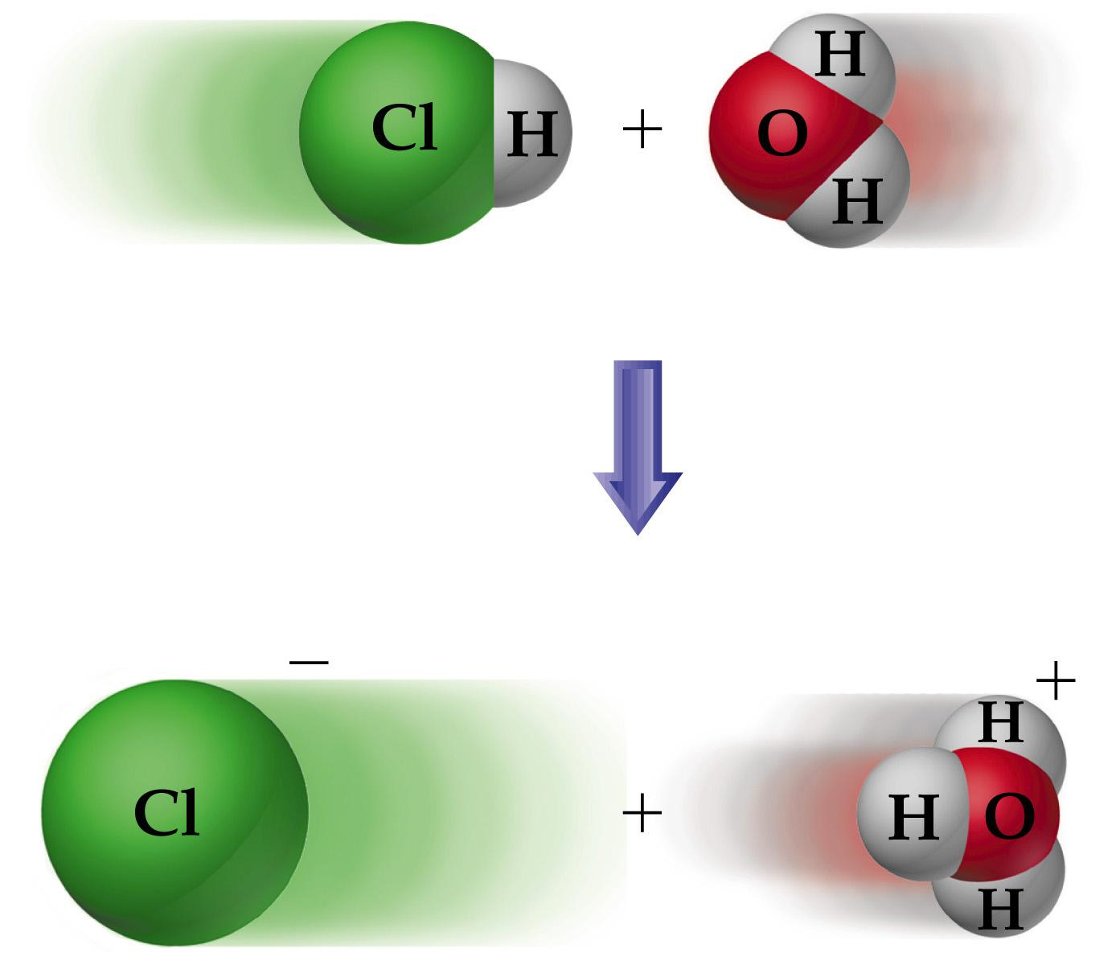

Slide 52
Problem
5a) Identify the acid and base in the following reaction.
acid
base

Slide 53
Problem
5b) Identify the acid and base in the following reaction.
NH₃ + H₂SO₄ → NH₄⁺ + HSO₄⁻
base
acid

Slide 54
Molarity and Dilution

Slide 55
Molarity
The concentration of a solution is the amount of solute present in a given quantity of solution.

Slide 56
Molarity
Molarity is the number of moles of solute in 1 liter of solution.
moles solute
Molarity =
liters of solution

Slide 58
Dilution
The procedure for preparing a less concentrated solution from a more concentrated one is called a dilution.
M₁ V₁ = M₂ V₂

Slide 59
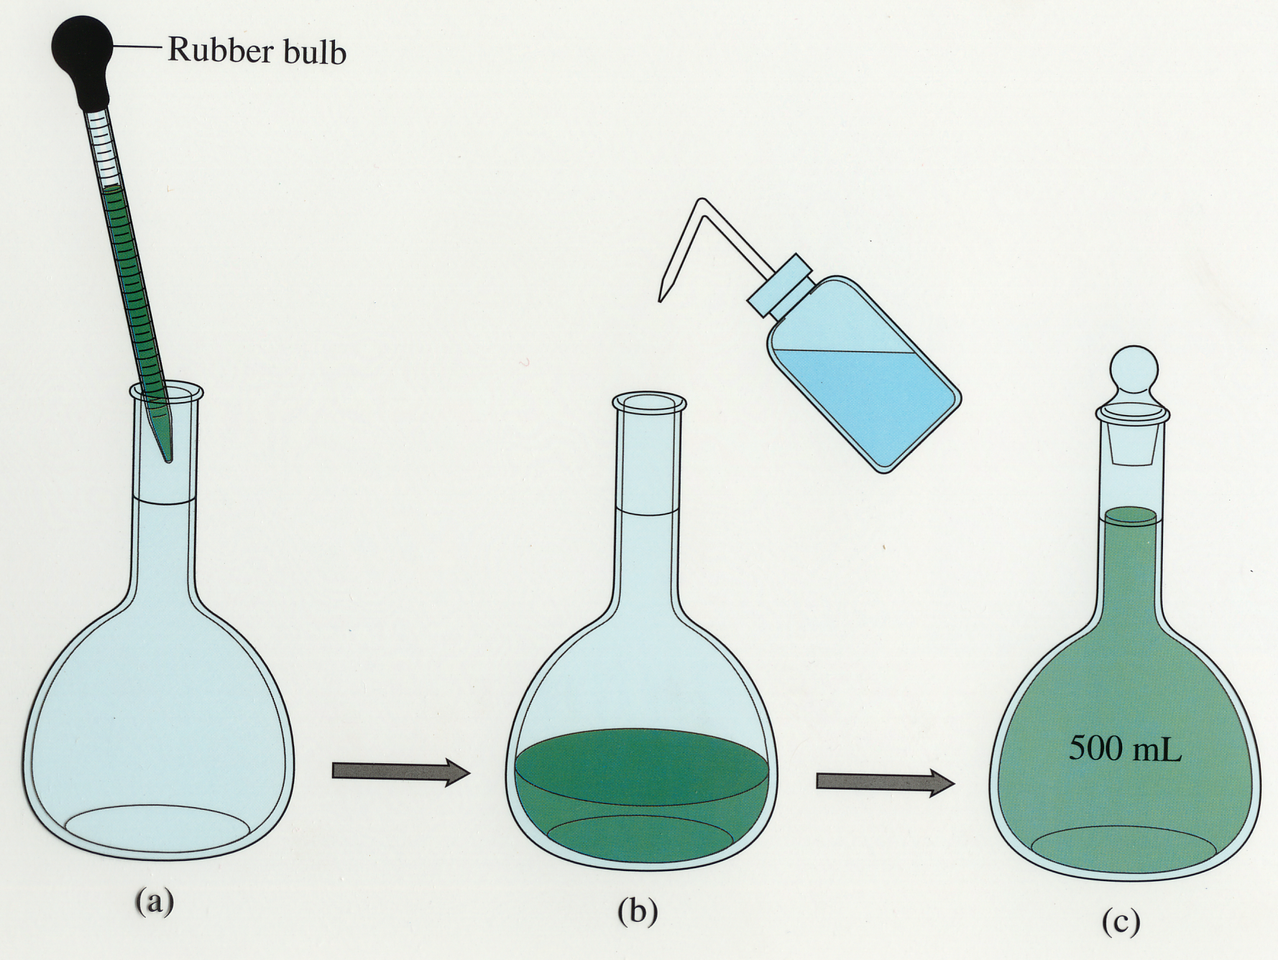

Slide 60
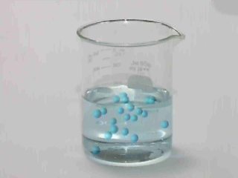

Slide 61
Problem
6) What is the molarity of an acetic acid (HC₂H₃O₂) solution with 4.0 moles dissolved in 250 mL of solution?
M = 16 M

Slide 62
Problem
7) How many moles of hydrochloric acid (HCl) are needed to make 3.0 L of a 0.55 M HCl solution?
moles = 1.7 moles

Slide 63
Problem
8) 0.600 moles of the base sodium hydroxide (NaOH) are dissolved in a small amount of water then diluted to 500. mL. What is the concentration?
(1.20 M)

Slide 64
Problem
9) 3.25 moles of the base potassium hydroxide (KOH) are dissolved in a small amount of water then diluted to 725 mL. What is the concentration?
(4.48 M)

Slide 65
Problem
10)How many moles are in 2.00 L of a 6.00 M solution of sulfuric acid (H₂SO₄)?
(12.0 mol)

Slide 66
Problem
11) How many moles are in 1250 mL of a 3.60 M solution of nitric acid (HNO₃)?
(4.50 mol)

Slide 67
Problem
12) 6.0 L of a 1.55 M LiOH solution are diluted to 8.8 L. What is the new molarity of the lithium hydroxide solution?
(M₂ = 1.1 M)

Slide 68
Problem
13) You have 250 mL of 6.0 M HCl. How many milliliters of 1.2 M HCl can you make?
V₂ = 1250 mL

Slide 69
Problem
14) 4.0 liters of a 0.75 M solution of sulfuric acid (H₂SO₄) are diluted to a 0.30 M solution. What is the final volume?
(V₂ = 10. L)

Slide 70
Problem
15) You need 350 mL of 0.25 M NaOH. All you have available is a 2.0 M stock solution of NaOH. How do you make the required solution?
V₂ = 44 mL, Add 44 mL of the stock solution and dilute to 350 mL; in other words, add 306 mL of distilled water to it.

Slide 71
Strength of Acids and Bases

Slide 72
Strong Bases
The strength of a base is based on the degree of dissociation.
The strength of a base does NOT depend on the molarity.
1A and 2A hydroxides, excluding Be, are strong bases.
Notes:
‹#›

Slide 73
Strong Bases
Some bases, such as Mg(OH)₂, are not very soluble in water, and they don’t produce a large number of OH– ions.
However, they are still considered to be strong bases because all the base that does dissolve completely dissociates.

Slide 74
Strong Acids
The strength of an acid is based on the degree of dissociation.
The strength of an acid does NOT depend on the molarity.
There are 6 strong acids: HCl, HBr, HI, HClO₄, HNO₃, and H₂SO₄.

Slide 75
Strength
Strong acids and bases are strong electrolytes because they dissociate completely.
Electrolytes conduct electricity.
Weak acids and bases don’t completely ionize so they are weak electrolytes.

Slide 76
Strength
Although the terms weak and strong are used to compare the strengths of acids and bases, dilute and concentrated are terms used to describe the concentration of solutions.

