Slide 1
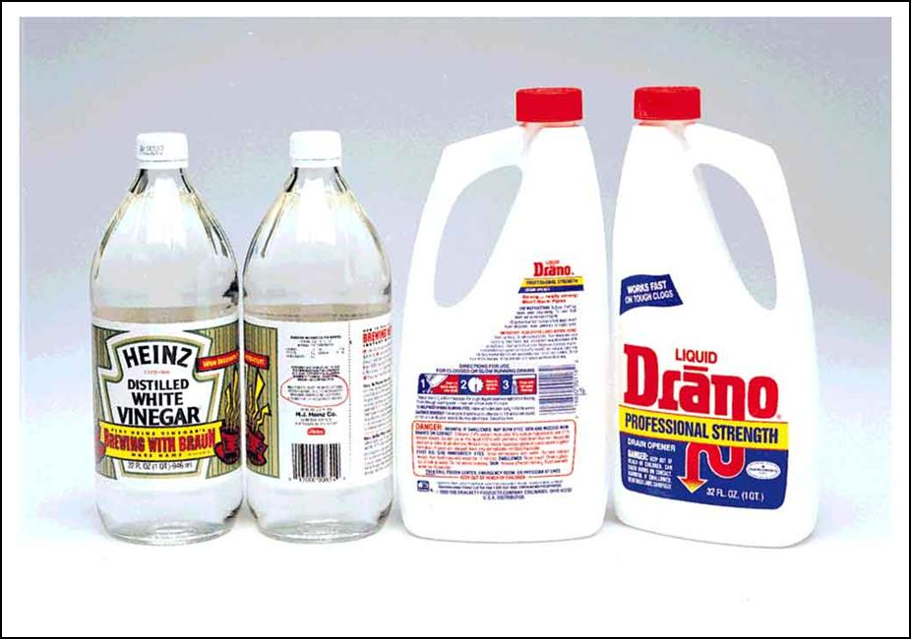
Acids and Bases
Part 2

Slide 2
The pH Scale
Notes:
‹#›

Slide 3
Water
Water ionizes; it falls apart into ions.
H₂O → H⁺ + OH⁻
The reaction above is called the self-ionization of water.

Slide 4
Water
[H⁺ ] = [OH⁻] = 1 x 10⁻⁷ M
When [H⁺ ] = [OH⁻], the solution is neutral.
At 25 °C K_{w} = [H⁺ ] x [OH⁻] = 1 x 10⁻¹⁴
K_{w} is called the ion-product constant.

Slide 5
Ion-Product Constant
If [H⁺] > [OH⁻], the solution is acidic.
The solution is basic when [OH⁻] > [H⁺].
Notes:
‹#›

Slide 6
pH
In most applications, the observed range of possible hydronium or hydroxide ion concentrations spans 10^{–14} M to 1M.
To make this range of possible concentrations easier to work with, the pH scale was developed.
Notes:
‹#›

Slide 7
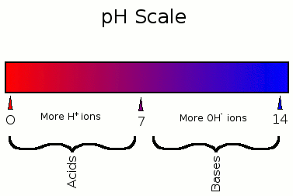
pH
pH is a mathematical scale in which the concentration of hydronium ions (H₃O⁺) in a solution is expressed as a number from 0 to 14.
Notes:
‹#›

Slide 8
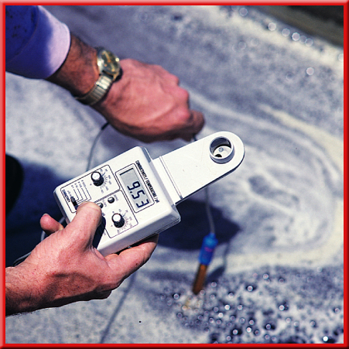
pH
pH meters are instruments that measure the exact pH of a solution.
Notes:
‹#›

Slide 9
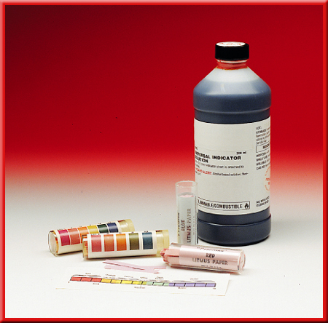
pH
Indicators register different colors at different pH’s.

Slide 10
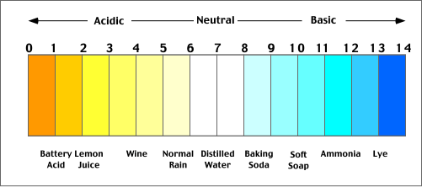
pH
pH = - log [H⁺]
In neutral solution, pH = 7.
In an acidic solution, pH < 7.
In a basic solution, pH > 7.

Slide 11
pH
As the pH drops from 7, the solution becomes more acidic.
As pH increases from 7, the solution becomes more basic.
alkaline (basic)

Slide 12
pH
The pH of a solution equals the negative logarithm of the hydrogen or hydronium ion concentration.

Slide 13
pH
pH “goes with” the terms hydrogen and hydronium.

Slide 14
pOH
The pOH of a solution equals the negative logarithm of the hydroxide ion concentration.

Slide 15
pOH
pOH “goes with” the term hydroxide.

Slide 16
pH and pOH
If either pH or pOH is known, the other may be determined by using the following relationship.

Slide 17
Problem
16a) Find the pH of the following solution. The hydronium ion concentration equals: 10^{–2} M (which = 1 x 10⁻² M)
pH = - log
(1 x 10⁻²)
[H+]
pH = 2

Slide 18
Problem
16b) Find the pH of the following solution. The hydrogen ion concentration equals: 10^{–11} M.
pH = - log
(1 x 10⁻¹¹)
[H+]
pH = 11

Slide 19
Problem
16c) Find the pH of the following solution. The hydronium ion concentration equals: 1 x 10^{–6} M.
pH = - log
(1 x 10⁻⁶)
[H+]
pH = 6

Slide 20
Problem
16d) Find the pH of the following solution. The hydroxide ion concentration equals: 10^{–8} M.
pOH = - log
(1 x 10⁻⁸)
[OH-]
pOH = 8
Notes:
‹#›

Slide 21
Problem, cont.
16d cont.) Find the pH of the following solution. The hydroxide ion concentration equals: 10^{–8} M.
pH + = 14
pOH
8
pH = 6
Notes:
‹#›

Slide 22
Problem
16e) Find the pH of the following solution. The hydroxide ion concentration equals: 10^{–5} M.
(pH = 9)

Slide 23
Problem
16f) Find the pH of the following solution. The hydroxide ion concentration equals: 10^{–3} M.
(pH = 11)

Slide 24
Problem
17) If a certain carbonated soft drink has a hydrogen ion concentration of 1.0 x 10^{–4} M, what are the pH and pOH of the soft drink?
(pH = 4)
(pOH = 10)
Notes:
‹#›

Slide 25
Problem
18) Find the pH if the hydrogen ion concentration equals: 3.25 x 10^{–3} M.
(pH = 2.49)
Notes:
‹#›

Slide 26
Problem
19) Find the pH if the hydroxide ion concentration equals: 7.36 x 10^{–5} M.
(pH = 9.87)

Slide 27
Problem
20) Find the pOH if the hydroxide ion concentration equals: 8.34 x 10^{–9} M.
(pOH = 8.08)

Slide 28
Problem
21) Find the pOH if the hydronium ion concentration equals: 1.45 x 10^{–4} M.
(pOH = 10.16)

Slide 29
Calculating Ion Concentrations From pH
If either pH or pOH is known, the hydrogen/hydronium ion or hydroxide ion can be found.
[H⁺] = 10^{-pH}
[OH⁻] = 10^{-pOH}
Notes:
‹#›

Slide 30
Calculating Ion Concentrations From pH
On a graphing calculator, hit
and then the number.
2nd
LOG
( )

Slide 31
Calculating Ion Concentrations From pH
On a scientific calculator, hit
the number
+/-
shift
LOG

Slide 32
Problem
22) Find the [H⁺] of a solution that has a pH equal to 6.
[H⁺] =
6
2nd
LOG
( )
[H⁺] = 1 x 10⁻⁶ M
Notes:
‹#›

Slide 33
Problem
23) Find the [H⁺] of a solution that has a pH equal to 12.
[H⁺] = 1 x 10⁻¹² M

Slide 34
Problem
24) Find the [H⁺] of a solution that has a pH equal to 5.
[H⁺] = 1 x 10⁻⁵ M

Slide 35
Example
25) Find the [H⁺] of a solution that has a pOH equal to 6.
pH + = 14
pOH
6
pH = 8

Slide 36
Example, cont
25) Find the [H⁺] of a solution that has a pOH equal to 6.
[H⁺] =
8
2nd
LOG
( )
[H⁺] = 1 x 10⁻⁸ M

Slide 37
Example, cont
26) Find the [OH⁻] of a solution that has a pOH equal to 6.
[OH⁻] =
6
2nd
LOG
( )
[H⁺] = 1 x 10⁻⁶ M

Slide 38
Problem
27) Find the [H⁺] of a solution that has a pOH equal to 2.
[H⁺] = 1 x 10⁻¹² M

Slide 39
Problem
28) Find the [H⁺] of a solution that has a pOH equal to 4.
[H⁺] = 1 x 10⁻¹⁰ M

Slide 40
Problem
29) Find the [OH⁻] of a solution that has a pH equal to 10.
[OH⁻] = 1 x 10⁻⁴ M

Slide 41
Problem
30) Find the [H⁺] of a solution that has a pH equal to 4.23.
[H⁺] = 5.89 x 10⁻⁵ M

Slide 42
Problem
31) Find the [H⁺] of a solution that has a pOH equal to 6.34.
[H⁺] = 2.19 x 10⁻⁸ M

Slide 43
Problem
32) Find the [OH⁻] of a solution that has a pH equal to 10.5.
[OH⁻] = 3.16 x 10⁻⁴ M

Slide 44
Problem
33) Find the [OH⁻] of a solution that has a pOH equal to 13.5.
[OH⁻] = 3.17 x 10⁻¹⁴ M

Slide 45
Calculating Ion Concentration From Ion Concentration
If either [H⁺] or [OH⁻] is known, the hydrogen ion or hydroxide ion can be found.
[H⁺] [OH⁻] = 1 x 10⁻¹⁴

Slide 46
Problem
34) Find the hydrogen ion concentration if the hydroxide ion concentration equals: 1 x 10^{–8} M.
[H⁺] = 1 x 10⁻¹⁴
1 x 10⁻⁸
[OH⁻]
[H⁺] = 1 x 10⁻⁶ M

Slide 47
Problem
35) Find the hydrogen ion concentration if the hydroxide ion concentration equals: 1 x 10^{–2} M.
[H⁺] = 1 x 10⁻¹⁴
1 x 10⁻²
[OH⁻]
[H⁺] = 1 x 10⁻¹² M

Slide 48
Problem
36) Find the hydroxide ion concentration if the hydrogen ion concentration equals: 1 x 10^{–4} M.
1 x 10⁻⁴
[H⁺]
[OH⁻] = 1 x 10⁻¹⁴
[OH⁻] = 1 x 10⁻¹⁰ M

Slide 49
Problem
37) Find the hydroxide ion concentration if the hydrogen ion concentration equals: 1 x 10^{–9} M.
1 x 10⁻⁹
[H⁺]
[OH⁻] = 1 x 10⁻¹⁴
[OH⁻] = 1 x 10⁻⁵ M
Notes:
‹#›

Slide 50
Problem
38) Find the hydrogen ion concentration if the hydroxide ion concentration equals: 3.25 x 10^{–3} M.
[H⁺] 3.25 x 10⁻³
[H⁺] = 1 x 10⁻¹⁴
[OH⁻]
[H⁺] = 3.08 x 10⁻¹² M
Notes:
‹#›

Slide 51
Problem
39) Find the hydroxide ion concentration if the hydrogen ion concentration equals: 6.44 x 10^{–6} M.
[H⁺]
[OH⁻] = 1 x 10⁻¹⁴
6.44 x 10⁻⁶
[OH⁻] = 1.55 x 10⁻⁹ M
Notes:
‹#›

Slide 52
Indicators
Notes:
‹#›

Slide 53
Indicators
Chemical dyes whose colors are affected by acidic and basic solutions are called indicators.
Many indicators do not have a sharp color change as a function of pH.
Most indicators tend to be red in more acidic solutions.
Notes:
‹#›

Slide 54
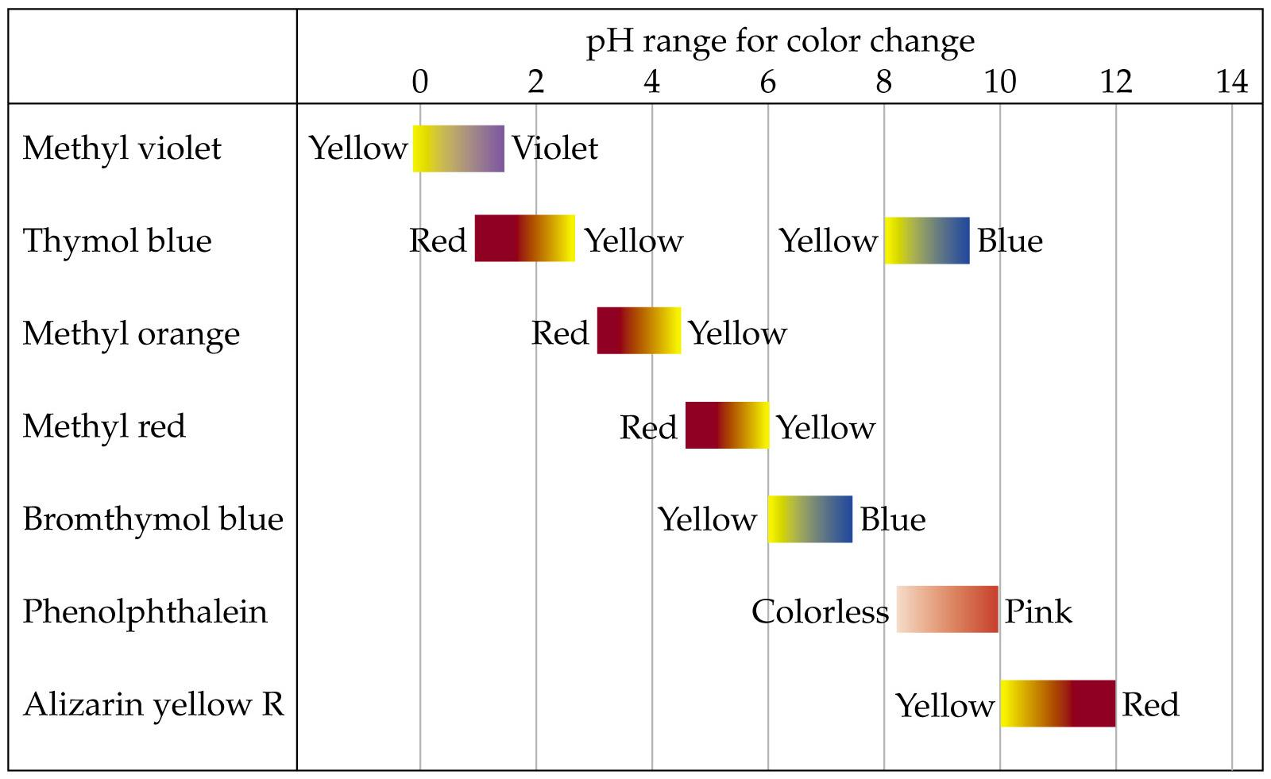
Indicators
Notes:
‹#›

Slide 55
Indicators
40) Which indicator is best to show an equivalence point pH of 4?
Methyl orange
Notes:
‹#›

Slide 56
Indicators
41) Which indicator is best to show an equivalence point pH of 11?
Alizarin yellow R
Notes:
‹#›

Slide 57
Indicators
42) Which indicator is best to show an equivalence point pH of 2?
Thymol blue
Notes:
‹#›

Slide 58
Neutralization Reactions
Notes:
‹#›

Slide 59
Neutralization Reactions
The reaction of an acid and a base is called a neutralization reaction.
Acid + Base → Salt + water
Salt = an ionic compound
Notes:
‹#›

Slide 60
Neutralization Reactions
Notes:
‹#›

Slide 61
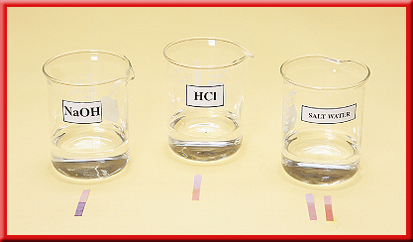
Neutralization Reactions
Consider the following neutralization reaction.
Notes:
‹#›

Slide 62
Neutralization Reactions
Notes:
‹#›

Slide 63
Neutralization Reactions

Slide 64
Example
43) Predict the products of and balance the following neutralization reaction. (Remember to check the oxidation numbers of the ions in the salt produced.)
a) HNO₃ + KOH →

Slide 65
Example, cont.
Predict the products of and balance the following neutralization reaction.
a) HNO₃ + KOH →
The salt is composed of the ___________ ion and the _______ ion.
potassium
nitrate

Slide 66
Example, cont.
Predict the products of and balance the following neutralization reaction.
a) HNO₃ + KOH →
1+
1-
K NO₃
Since the 2 oxidation numbers add to give zero, you do not need to criss-cross.

Slide 67
Example, cont.
Predict the products of and balance the following neutralization reaction.
a) HNO₃ + KOH →
KNO₃ + H₂O

Slide 68
Problem
Predict the products of and balance the following neutralization reaction. (Remember to check the oxidation numbers of the ions in the salt produced.)
b) HCl + Mg(OH)₂ →
2
MgCl₂ + 2H₂O
Notes:
‹#›

Slide 69
Problem
Predict the products of the following neutralization reaction. (Remember to check the oxidation numbers of the ions in the salt produced.)
c) H₂SO₄ + NaOH →
2
Na₂SO₄ + 2H₂O
Notes:
‹#›

Slide 70
Neutralization

Slide 71
Problem
44) How many moles of HNO₃ are needed to neutralize 0.86 moles of KOH?
HNO₃ + KOH → KNO₃ + H₂O
1 mole HNO₃
0.86 moles KOH
=
1 mole KOH
0.86 moles KOH

Slide 72
Problem
45) How many moles of HCl are needed to neutralize 3.5 moles of Mg(OH)₂?
2HCl + Mg(OH)₂ → MgCl₂ + 2H₂O
2 mol HCl
3.5 moles Mg(OH)₂
=
1 mol Mg(OH)₂
7.0 moles HCl

Slide 73
Problem
46) How many moles of H₃PO₄ are needed to neutralize 3.5 moles of Mg(OH)₂?
2H₃PO₄ + 3Mg(OH)₂ → Mg₃(PO₄)₂ + 6H₂O
2.3 moles H₃PO₄

Slide 74
Problem
47) How many moles of HC₂H₃O₂ are needed to neutralize 3.5 moles of Cr(OH)₃?
3HC₂H₃O₂ + Cr(OH)₃ → Cr(C₃H₃O₂)₃ + 3H₂O
11 moles HC₂H₃O₂

Slide 75
Problem
48) If it takes 87 mL of an HCl solution to neutralize 0.67 moles of Mg(OH)₂ what is the concentration of the HCl solution?
2HCl + Mg(OH)₂ → 2KCl + 2H₂O
2 mol HCl
0.67 moles Mg(OH)₂
=
1 mol Mg(OH)₂
1.3 moles HCl

Slide 76
Problem, cont.
48) If it takes 87 mL of an HCl solution to neutralize 0.67 moles of Mg(OH)₂ what is the concentration of the HCl solution?
1.3 mol
moles
M =
0.087 L
liters
M = 15 M
Notes:
‹#›

Slide 77
Problem
49) If it takes 58 mL of an H₂SO₄ solution to neutralize 0.34 moles of NaOH what is the concentration of the H₂SO₄ solution?
H₂SO₄ + 2NaOH → Na₂SO₄ + 2H₂O
1 mol H₂SO₄
0.34 moles NaOH
=
2 mol NaOH
0.17 moles H₂SO₄

Slide 78
Problem, cont.
49) If it takes 58 mL of an H₂SO₄ solution to neutralize 0.34 moles of NaOH what is the concentration of the H₂SO₄ solution?
0.17 mol
moles
M =
0.058 L
liters
M = 2.9 M
Notes:
‹#›

Slide 79
Problem
50) If it takes 85 mL of an HNO₃ solution to neutralize 0.54 moles of Mg(OH)₂ what is the concentration of the HNO₃ solution?
2HNO₃ + Mg(OH)₂ → Mg(NO₃)₂ + 2H₂O
M = 13 M

Slide 80
Problem
51) If it takes 150. mL of an Ca(OH)₂ solution to neutralize 0.800 moles of HCl what is the concentration of the Ca(OH)₂ solution?
2HCl + Ca(OH)₂ → CaCl₂ + 2H₂O
M = 2.67 M
Notes:
‹#›

Slide 81
Acid Rain

Slide 82
Acid Rain
Acid Rain is any rain with a pH less than 5.6.
Pure rain is naturally acidic because of dissolved CO₂.
It is caused by the man-made oxides of sulfur and nitrogen.
SO₃ + H₂O ➔ H₂SO₄

Slide 83
Acid Rain
Research shows acid rain is associated with parts of a country where heavy industries are situated & also down-wind from such sites.
Analysis of acid rain indicates that especially sulfur oxides, SO_{x} and nitrogen oxides, NO_{x} are mostly responsible from rain acidity.

Slide 84
Acid Rain
Snow fog, sleet, hail and drizzle all become contaminated with acids when SO_{x} and NO_{x} are present as pollutants.

Slide 85
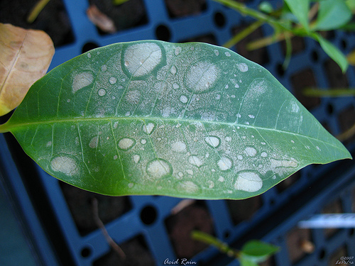
Acid Rain
Acid Rain damage caused by all the fires and ash in the air.

Slide 86
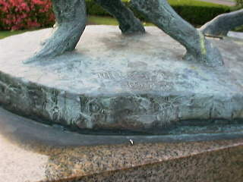
Acid Rain
More damage from Acid Rain.

Slide 87
Titration
Notes:
‹#›

Slide 88
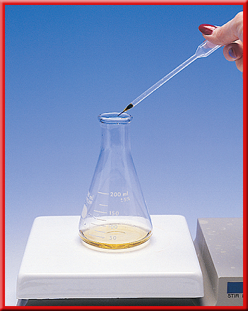
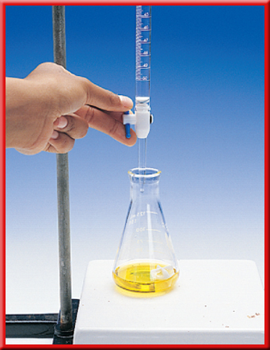
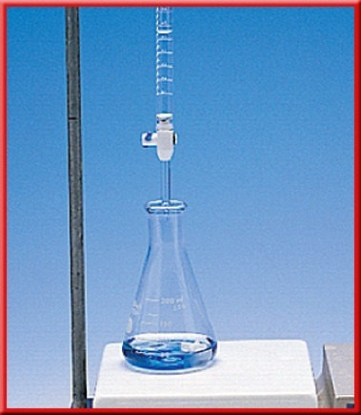
Titration
Determining an Unknown
Notes:
‹#›

Slide 89
Titration
The general process of determining the molarity of an acid or a base through the use of an acid-base reaction is called an acid-base titration.
Notes:
‹#›

Slide 90
Titration
Notes:
‹#›

Slide 91
Titration
The known reactant molarity is used to find the unknown molarity of the other solution.
Solutions of known molarity that are used in this fashion are called standard solutions.
Notes:
‹#›

Slide 92
Titration
In a titration, the molarity of one of the reactants, acid or base, is known, but the other is unknown.

Slide 93
Problem
52) A 15.0-mL sample of a solution of H₂SO₄ with an unknown molarity is titrated with 32.4 mL of 0.145M NaOH to the bromothymol blue endpoint. Based upon this titration, what is the molarity of the sulfuric acid solution?
H₂SO₄ + 2NaOH → Na₂SO₄ + 2H₂O

Slide 94
Problem, cont.
First find the number of moles of the solution for which you know the molarity and volume.
… is titrated with 32.4 mL of 0.145M NaOH …
x
moles
0.145 M =
M =
0.0324 L
liters
x = 4.70 x 10⁻³ moles NaOH

Slide 95
Problem, cont.
Next, use the mole-mole ratio to determine the moles of the unknown.
H₂SO₄ + 2NaOH → Na₂SO₄ + 2H₂O
1 mol H₂SO₄
4.70 x 10⁻³ mol NaOH
=
2 mol NaOH
2.35 x 10⁻³ moles H₂SO₄

Slide 96
Problem, cont.
Finally, determine the molarity of the unknown solution.
A 15.0-mL sample of a solution of H₂SO₄…
2.35 x 10⁻³ mol
moles
M =
0.015 L
liters
M = 0.157 M

Slide 97
Problem
53) If it takes 45 mL of a 1.0 M NaOH solution to neutralize 57 mL of HCl, what is the concentration of the HCl ?
HCl + NaOH → NaCl + H₂O
(0.79 M)

Slide 98
Problem
54) If it takes 67.0 mL of 0.500 M H₂SO₄ to neutralize 15.0 mL of Al(OH)₃ what was the concentration of the Al(OH)₃ ?
3H₂SO₄ + 2Al(OH)₃ → Al₂(SO₄)₃ + 6H₂O
(1.49 M)
Notes:
‹#›

Slide 99
Problem
55) How many moles of 0.275 M HCl will be needed to neutralize 25.0 mL of 0.154 M NaOH?
HCl + NaOH → NaCl + H₂O
(0.00385 moles)
Notes:
‹#›

Slide 100
Titration Curves
Notes:
‹#›

Slide 101
Titration Curves
A plot of pH versus volume of acid (or base) added is called a titration curve.

Slide 102
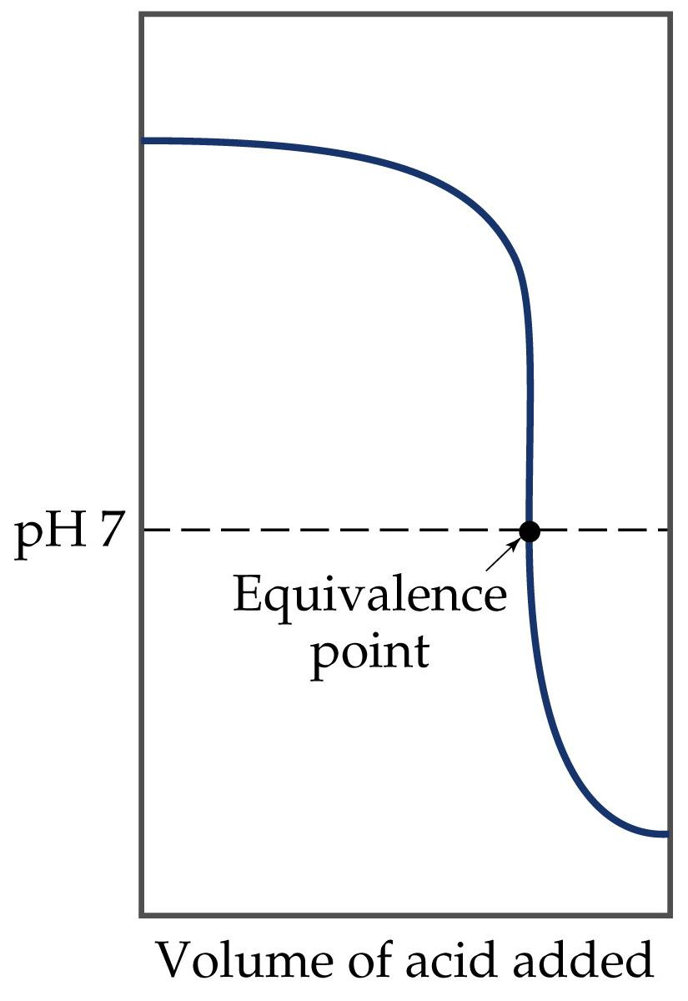
Titration Curves
Strong Base-Strong Acid Titration Curve

Slide 103
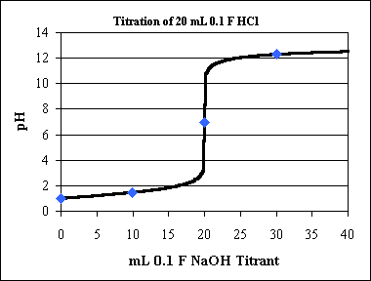
Titration Curves
Consider adding a strong base (e.g. NaOH) to a solution of a strong acid (e.g. HCl).
M HCl
M

Slide 104
Titration Curves
Before any base is added, the pH is given by the strong acid solution. Therefore, pH < 7.
M HCl
M

Slide 105
Titration Curves
When base is added, before the equivalence point, the pH is given by the amount of strong acid in excess. Therefore, pH < 7.
M HCl
equivalencepoint
M

Slide 106
Titration Curves
At equivalence point, the amount of base added is stoichiometrically equivalent to the amount of acid originally present. Therefore, pH = 7.
M HCl
M

Slide 107
Titration Curves
To detect the equivalent point, we use an indicator that changes color somewhere near 7.00.

Slide 108
Titration Curves
Past the equivalence point all acid has been consumed. Thus one need only account for excess base. Therefore, pH > 7.
M HCl
M

