Slide 1
BONDING

Slide 2
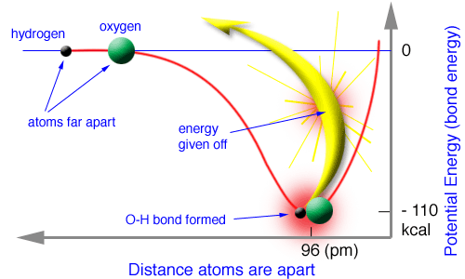
Bonding
As atoms bond with each other, they decrease their potential energy, thus creating more stable arrangements of matter.

Slide 3
Types of Bonding
The force that holds two atoms together is called a chemical bond.
There are 3 types of bonding:
ionic,
covalent, and
metallic.

Slide 4
Notes:
‹#›

Slide 5
Keeping Track of Electrons
The number of valence electrons are easily found by looking up the group number on the periodic table.

Slide 6
Electron Configurations for Cations
Remember that metals lose electrons to attain noble gas configuration.
They make positive ions, cations.
Notes:
‹#›

Slide 7
Electron Configurations for Representative Metals
EXAMPLE: Sodium
Na 1s²2s²2p⁶3s¹
Na 1s²2s²2p⁶3s¹
The electron that is removed comes from the highest energy level.
Na⁺ 1s²2s²2p⁶ - noble gas configuration

Slide 8
Example
Determine the number of valence electrons of calcium (Ca).
2
Draw the Lewis dot diagram for calcium (Ca).
Ca

Slide 9
Example
Will calcium form a cation or an anion?
cation
Draw the Lewis dot diagram for the calcium ion.
[Ca]²⁺

Slide 10
Electron Configurations for Transition Metals
For transition metals, electrons are lost to acquire stable arrangements in the ‘d’ sublevel, either filled or half-filled.
When transition metals are oxidized (become positively charged ions) they lose their outer s electrons before they lose electrons from the d subshell.
Notes:
‹#›

Slide 11
Electron Configurations for Transition Metals
EXAMPLE: Iron
Fe 1s² 2s² 2p⁶ 3s² 3p⁶ 4s² 3d⁶
Fe 1s² 2s² 2p⁶ 3s² 3p⁶ 4s² 3d⁶
The electrons that are removed come from the highest energy level and/or the d sublevel.
Fe³⁺ 1s² 2s² 2p⁶ 3s² 3p⁶ 3d⁵

Slide 12
Electron Configurations for Anions
Nonmetals gain electrons to attain noble gas configuration.
This means they want an octet of electrons, 8 electrons.
They make negative ions, anions.

Slide 13
Electron Configurations for Anions
EXAMPLE: Sulfur
S 1s²2s²2p⁶3s²3p⁴
S 1s²2s²2p⁶3s²3p⁴
Sulfur has 6 valence electrons and needs to gain 2 more to have an octet.
S²⁻ 1s²2s²2p⁶3s²3p⁶ - noble gas configuration

Slide 14
Example
Determine the number of valence electrons of phosphorus (P).
5
Draw the Lewis dot diagram for phosphorus (P).
P
Notes:
‹#›

Slide 15
Example
Will phosphorus form a cation or an anion?
anion
Draw the Lewis dot diagram for the phosphorus ion.
[
]
P ³⁻

Slide 16
Stable Electron Configurations
Noble gases, except He, have 2 s electrons and 6 p electrons, totaling 8 valence electrons.
They obey the octet rule.
Ar
Notes:
‹#›

Slide 17
Problem
Predict the ionic charge for the following representative elements.
a) rubidium (Rb)
b) bromine (Br)
c) silicon (Si)
1+
d) barium (Ba)
e) boron (B)
f) selenium (Se)
2+
1-
3+
4+ or 4-
2-
Notes:
‹#›

Slide 18
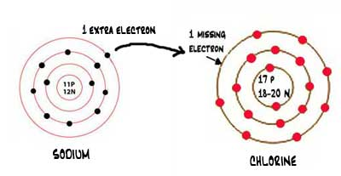
IONIC
BONDING
Notes:
‹#›

Slide 19
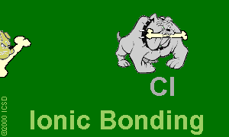
Ionic Bonds: One big greedy thief dog!
Ionic bonding can be best imagined as one big greedy dog stealing the other dog's bone.
Notes:
‹#›

Slide 20
Ionic Bonds: One big greedy thief dog!
If the bone represents the electron that is up for grabs, then when the big dog gains an electron he becomes negatively charged and the little dog who lost the electron becomes positively charged.
Notes:
‹#›

Slide 21
Ionic Bonds: One big greedy thief dog!
The two ions (that's where the name ionic comes from) are attracted very strongly to each other as a result of the opposite charges.
Notes:
‹#›

Slide 22
Ionic Bonding
Anions and cations are involved in ionic bonding and are held together by opposite charges, electrostatic attraction.
Notes:
‹#›

Slide 23
Ionic Bonding
The bond is formed through the transfer of electrons.
Electrons are transferred to achieve noble gas configuration.
Ionic bonds occur between metals and nonmetals.
Notes:
‹#›

Slide 24
Ionic Bonding
Na
Cl
Notes:
‹#›

Slide 25
Ionic Bonding
Na⁺
Cl ⁻
Notes:
‹#›

Slide 26
Ionic Bonding
All the electrons must be accounted for!
Ca
P
Notes:
‹#›

Slide 27
Ionic Bonding
Ca
P
Notes:
‹#›

Slide 28
Ionic Bonding
Ca²⁺
P²⁻
There is still an unpaired electron for phosphorus, so another calcium is needed.
Notes:
‹#›

Slide 29
Ionic Bonding
Ca²⁺
P²⁻
Ca
Notes:
‹#›

Slide 30
Ionic Bonding
Ca²⁺
P³⁻
1+
Ca
Now Ca has an unpaired electron, so another P is needed.
Notes:
‹#›

Slide 31
Ionic Bonding
Ca²⁺
P³⁻
Ca¹⁺
P
Notes:
‹#›

Slide 32
Ionic Bonding
Ca²⁺
P³⁻
Ca²⁺
P¹⁻
This P has 2 unpaired electrons, so one more Ca is needed.

Slide 33
Ionic Bonding
Ca
P³⁻
Ca²⁺
P¹⁻
Ca²⁺

Slide 34
Ionic Bonding
Ca
P³⁻
Ca²⁺
Ca²⁺
P¹⁻
Notes:
‹#›

Slide 35
Ionic Bonding
Ca²⁺
P³⁻
Ca²⁺
P³⁻
Ca²⁺
Notes:
‹#›

Slide 36
Ionic Bonding
Ca₃P₂
Formula Unit
Notes:
‹#›

Slide 37
Ionic Compounds
A compound that is composed of ions is called an ionic compound.
Note that only the arrangement of electrons has changed. Nothing about the atom’s nucleus has changed.

Slide 38
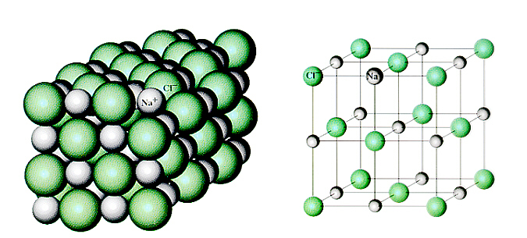
Properties of Ionic Compounds
Ionic compounds have a crystalline structure, a regular repeating arrangement of ions in the solid.

Slide 39
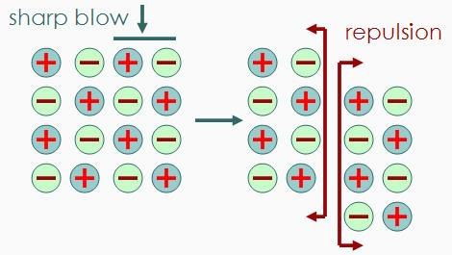
Properties of Ionic Compounds
Even though the ions are strongly bonded to one another, ionic compounds are brittle.

Slide 40
Properties of Ionic Compounds
Ionic compounds are hard solids.
They have high melting points and high boiling points because of strong forces between ions.
They conduct electricity in the molten (melted) and dissolved states (in aqueous solution) and thus are considered electrolytes.

Slide 41
Question
How many valence electrons must an atom have in its outer energy level in order to be considered stable?
(eight)

Slide 42
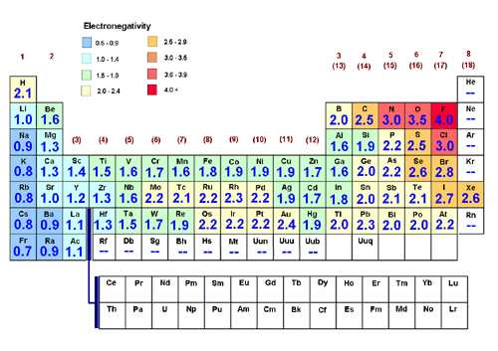
Electronegativity Difference
A bond that is predominately ionic has an electronegativity difference greater than 1.7.

Slide 43
Electronegativity Difference
Use electronegativity values to validate that NaCl is predominately ionic.
3.0 – 0.9 = 2.1
2.1 > 1.7 so NaCl is ionic.

Slide 44
Electronegativity Difference
Use electronegativity values to validate that CaF₂ is predominately ionic.
4.0 – 1.3 = 2.7
2.7 > 1.7 so CaF₂ is ionic.

Slide 46
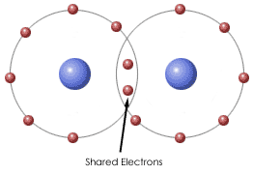
COVALENT
BONDING
Notes:
‹#›

Slide 47
Covalent Compounds
A molecule is an uncharged group of two or more atoms held together by covalent bonds.
The attraction of two atoms for a shared pair of electrons is called a covalent bond.

Slide 48
Covalent Bonds
Covalent bonds occur between 2 nonmetals because nonmetals hold onto their valence electrons.
They can’t give away electrons to bond, yet, they still want noble gas configuration.

Slide 49
Covalent Bonds
They get the stable configuration by sharing valence electrons with each other.
By sharing, both atoms get to count the electrons toward the noble gas configuration.
Notes:
‹#›

Slide 50
Covalent Bonding
Covalent bonds can be polar or nonpolar.

Slide 51
Nonpolar Covalent Bonds: Dogs of equal strength
Nonpolar covalent bonds can be thought of as two or more dogs with equal attraction to the bones.
Notes:
‹#›

Slide 52
Nonpolar Covalent Bonds: Dogs of equal strength
Since the dogs (atoms) are identical, then the dogs share the pairs of available bones evenly.
Since one dog does not have more of the bone than the other dog, the charge is evenly distributed among both dogs.

Slide 53
Nonpolar Covalent Bonds: Dogs of equal strength
The molecule is not "polar" meaning one side does not have more charge than the other.
Notes:
‹#›

Slide 54
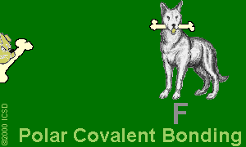
Polar Covalent Bonds: Unevenly matched dogs, but willing to share
Polar covalent bonds can be thought of as two or more dogs that have different desire for bones.

Slide 55
Polar Covalent Bonds: Unevenly matched dogs, but willing to share
The bigger dog has more strength to possess a larger portion of the bones.
Sharing still takes place but is an uneven sharing.

Slide 56
Polar Covalent Bonds: Unevenly matched dogs, but willing to share
In the case of the atoms, the electrons spend more time on the end of the molecule near the atom with the greater electronegativity (desire for the electron) making it seem more negative and the other end of the molecule seem more positive.

Slide 57
Covalent Bonding
Fluorine has seven valence electrons.
F

Slide 58
Covalent Bonding
A second fluorine atom also has seven valence electrons.
F
F

Slide 59
Covalent Bonding
Each fluorine atom will share its single lone electron.
F
F
Notes:
‹#›

Slide 60
Covalent Bonding
F
F
The fluorine atoms are getting closer together in order to share their lone electrons.
Notes:
‹#›

Slide 61
Covalent Bonding
F
F
Notes:
‹#›

Slide 62
Covalent Bonding
F
F
Notes:
‹#›

Slide 63
Covalent Bonding
F
F
Notes:
‹#›

Slide 64
Covalent Bonding
Both end with full orbitals.
F
F
Notes:
‹#›

Slide 65
Covalent Bonding
The fluorine on the right has 8 valence electrons!
F
F
8 valence electrons
Notes:
‹#›

Slide 66
Covalent Bonding
The fluorine on the left has 8 valence electrons!
F
F
8 valence electrons
Notes:
‹#›

Slide 67
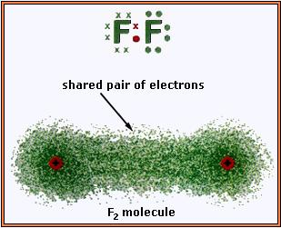
Covalent Bonding
Notes:
‹#›

Slide 68
Water
Each hydrogen has 1 valence electron.
Each hydrogen wants 1 more.
H
Notes:
‹#›

Slide 69
Water
O
The oxygen has 6 valence electrons.
The oxygen wants 2 more.
Notes:
‹#›

Slide 70
Water
Hydrogen and oxygen share to make each other happy.
The first hydrogen is happy, but the oxygen still wants one more electron.
H
O
Notes:
‹#›

Slide 71
Water
A second hydrogen attaches.
Every atom has full energy levels.
H
O
H

Slide 72
Properties of Covalent Compounds
Most covalent compounds have low melting points and boiling points because the forces between molecules are weak.
They are poor conductors of electricity, so they are considered nonelectrolytes.
Notes:
‹#›

Slide 73
Properties of Covalent Compounds
Covalent compounds tend to be gases, liquids or soft solids.
Many are polar in nature.
Notes:
‹#›

Slide 74
Electronegativity Difference
The electronegativity difference for two elements in a covalent compound is less than 1.7.

Slide 75
Electronegativity Difference
Use electronegativity values to validate that CO₂ is predominately covalent.
3.5 – 2.5 = 1.0
1.0 < 1.7 so CO₂ is covalent.

Slide 76
Question
Do atoms that share a covalent bond have an ionic charge?
(No, the atoms share electrons and neither atom has a charge.)

Slide 77
Question
7) Ionic (I), covalent (C), or both (B)?
a) NaCl _____ b) CaCO₃ _____
c) CS₂ _____ d) Zn₃PO₄ _____
e) GaH₃ _____ f) N₂O₅ _____
g) H₂O _____ h) CuO _____
i) FCl _____ j) SO₃ _____
k) SiCl₄ _____ l) BN _____
I
B
C
B
I
C
C
I
C
C
C
C

Slide 78
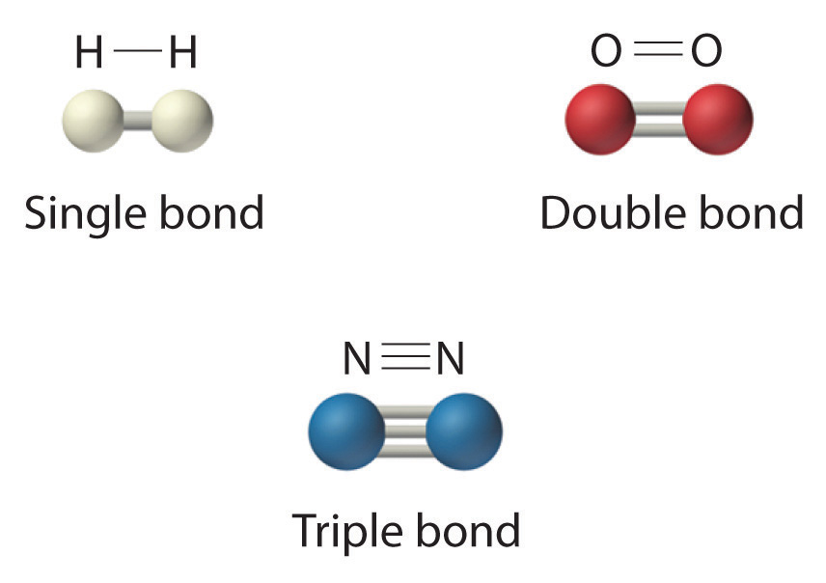
Multiple Bonds
Bonds can be single, double or triple.
Notes:
‹#›

Slide 79
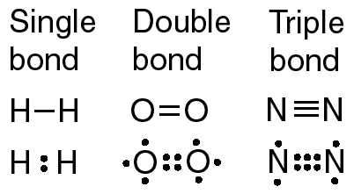
Multiple Bonds
A single bond is formed from the sharing of 2 valence electrons, a double bond from 4 valence electrons, and a triple bond from 6 valence electrons.

Slide 80
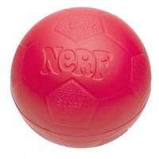
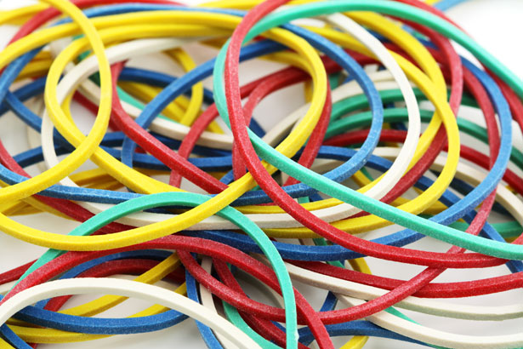
Multiple Bonds
In what way does a bond change as the number of shared electrons increases?
One analogy you can use is to think about atoms as nerf balls and bonds as rubber bands.
Notes:
‹#›

Slide 81
Multiple Bonds
The rubber bands act as the force which holds the balls together, as we increase the number of rubber bands the balls are squished closer together and it takes more force to pull them apart.
Notes:
‹#›

Slide 82
Multiple Bonds
In a molecule as you increase the number of electrons shared between two atoms, you increase the strength of the bond, increase the bond energy, and decrease the distance between nuclei.
Notes:
‹#›

Slide 83
Multiple Bonds
Triple bonds are stronger than double bonds, and double bonds are stronger than single bonds.
Notes:
‹#›

Slide 84
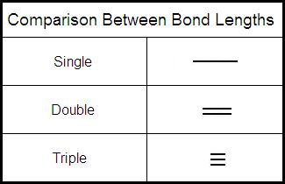
Multiple Bonds
Triple bonds are shorter than double bonds, and double bonds are shorter than single bonds.
Notes:
‹#›

Slide 85
Multiple Bonds
Bond energy (bond enthalpy) is the energy required to break a bond.
Stronger bonds have greater bond energy.
Triple bonds have greater bond energy than double bonds, and double bonds have greater bond energy than single bonds.
Notes:
‹#›

Slide 86
Multiple Bonds
Hydrogen and the halogens CANNOT form double or triple bonds!
Notes:
‹#›

Slide 87
Carbon Dioxide
CO₂ - Carbon is central atom ( I have to tell you)
Carbon has 4 valence electrons
Wants 4 more
Oxygen has 6 valence electrons
Wants 2 more
C
O
Notes:
‹#›

Slide 88
Carbon Dioxide
Attaching 1 oxygen leaves the oxygen 1 electron short and the carbon 3 electrons short
C
O
Notes:
‹#›

Slide 89
Carbon Dioxide
Attaching the second oxygen leaves both oxygen 1 short and the carbon 2 short
O
C
O
Notes:
‹#›

Slide 90
Carbon Dioxide
The only solution is to share more.
O
C
O
Notes:
‹#›

Slide 91
Carbon Dioxide
O
C
O
Notes:
‹#›

Slide 92
Carbon Dioxide
O
C
O
Notes:
‹#›

Slide 93
Carbon Dioxide
O
C
O

Slide 94
Carbon Dioxide
O
C
O
Notes:
‹#›

Slide 95
Carbon Dioxide
O
C
O

Slide 96
Carbon Dioxide
Requires two double bonds
Each atom gets to count all the atoms in the bond
O
C
O

Slide 97
Carbon Dioxide
8 valence electrons
O
C
O

Slide 98
Carbon Dioxide
8 valence electrons
O
C
O

Slide 99
Carbon Dioxide
8 valence electrons
O
C
O

Slide 100
The Wetter Way
You can easily determine the number of bonds in a compound by performing the “Wetter Way.”
Σe- after – Σe- before
# bonds =
2

Slide 101
The Wetter Way
The number of electrons before bonding is equal to the column number.
To get the number of electrons after bonding, double the # of electrons before bonding BUT DO NOT EXCEED 8!

Slide 102
Example – CO₂
C
C is in column 4A and therefore has 4 valence electrons before bonding
O is in column 6A and therefore has 6 valence electrons before bonding
O

Slide 103
Example – CO₂
Σ electrons before bonding
Carbon = 4
Two oxygens = 6 x 2 = 12
The formula CO₂ implies there are 2 oxygen atoms.
Σ electrons before bonding =
4 + 12 = 16

Slide 104
Example – CO₂
C – 4 valence e- before bonding, so it has (4x2) = 8 electrons after bonding
O – 6 valence e- before bonding, so it has (6x2) = 12
C
O
8
8 is the maximum electrons after bonding

Slide 105
Example – CO₂
Σ electrons after bonding
Carbon = 8
Two oxygens = 8 x 2 = 16
The formula CO₂ implies there are 2 oxygen atoms.
Σ electrons after bonding =
8 + 16 = 24

Slide 106
Example – CO₂
after
__ + __ x 2 =
8
8
24
CO₂
__ + __ x 2 =
before
4
6
16

Slide 107
The Wetter Way
Σe- after – Σe- before
# bonds =
2
24 – 16
= 4
# bonds =
2
CO₂ has 4 bonds!

Slide 108
Carbon Dioxide
The element you have only 1 of goes in the center.
O
C
O
The other elements surround it.

Slide 109
Carbon Dioxide
Connect the elements with a single line (a single bond).
O
C
O
You have only used 2 of your calculated 4 bonds, so you need to double up.

Slide 110
Carbon Dioxide
A line represents 2 electrons. Count your lines for each element to determine if extra electrons need to be added.
O
C
O

Slide 111
Carbon Dioxide
Carbon has 4 lines attached which represents 8 electrons. No extra electrons are needed around carbon.
O
C
O

Slide 112
Carbon Dioxide
Each oxygen has 2 lines attached which represents 4 electrons. Oxygen needs 8 electrons after bonding, so each oxygen needs 4 electrons (dots).
O
C
O

Slide 113
Example – NH₃
N
N is in column 5A and therefore has 5 valence electrons before bonding
H is in column 1A and therefore has 1 valence electron before bonding
H

Slide 114
Example – NH₃
Σ electrons before bonding
nitrogen = 5
three hydrogens = 1 x 3 = 3
The formula NH₃ implies there are 3 hydrogen atoms.
Σ electrons before bonding =
5 + 3 = 8

Slide 115
Example – NH₃
N – 5 valence e- before bonding, so it has (5x2) = 10 electrons after bonding
H – 1 valence e- before bonding, so it has (1x2) = 2 electrons after bonding
N
8
H

Slide 116
Example – NH₃
Σ electrons after bonding
nitrogen = 8
3 hydrogens = 2 x 3 = 6
The formula NH₃ implies there are 3 hydrogen atoms.
Σ electrons after bonding =
8 + 6 = 14

Slide 117
Example – NH₃
after
__ + __ x 3 =
8
2
14
NH₃
__ + __ x 3 =
before
5
1
8

Slide 118
The Wetter Way
Σe- after – Σe- before
# bonds =
2
14 – 8
= 3
# bonds =
2
NH₃ has 3 bonds!

Slide 119
Ammonia
The element you have only 1 of goes in the center.
H
N
H
H
The other elements surround it.

Slide 120
Ammonia
Connect the elements with a single line (a single bond).
H
N
H
H
You have used all 3 of your calculated bonds.

Slide 121
Ammonia
A line represents 2 electrons. Count your lines for each element to determine if extra electrons need to be added.
H
N
H
H

Slide 122
Ammonia
Nitrogen has 3 lines attached which represents 6 electrons. Two extra electrons are needed around nitrogen.
H
N
H
H

Slide 123
Ammonia
Each hydrogen has 1 line attached which represents 2 electrons. No extra electrons are needed around the hydrogen atoms.
H
N
H
H

Slide 124
Problem
Determine the number of bonds, using the Wetter Way, and draw the dot-dash diagram for HBr.
1 bond
H
Br

Slide 125
Problem
Determine the number of bonds, using the Wetter Way, and draw the dot-dash diagram for N₂.
3 bonds
N
N

Slide 126
Problem
Determine the number of bonds, using the Wetter Way, and draw the dot-dash diagram for HCN.
4 bonds
H−C
N

Slide 127
Ozone – O₃
O
O is in column 6A and therefore has 6 valence electrons before bonding

Slide 128
Ozone – O₃
Σ electrons before bonding
Three oxygens = 6 x 3 = 18
The formula O₃ implies there are 3 oxygen atoms.
Σ electrons before bonding = 18

Slide 129
Ozone – O₃
O – 6 valence e- before bonding, so it has (6x2) = 12
O
8
8 is the maximum electrons after bonding

Slide 130
Ozone – O₃
Σ electrons after bonding
Three oxygens = 8 x 3 = 24
Σ electrons after bonding = 24

Slide 131
Example – O₃
after
__ x 3 =
8
24
O₃
6
__ x 3 =
before
18

Slide 132
The Wetter Way
Σe- after – Σe- before
# bonds =
2
24 – 18
= 3
# bonds =
2
O₃ has 3 bonds!

Slide 133
Ozone
Place the 3 oxygen atoms on a line.
O
O
O

Slide 134
Ozone
Connect the elements with a single line (a single bond).
O
O
O
You have only used 2 of your calculated 3 bonds, so you need to double up one side.

Slide 135
Ozone
But you could have doubled the left side!
O
O
O

Slide 136
Ozone
Look at the oxygen that has a single line attached. 6 extra electrons are needed around these oxygen atoms.
O
O
O
O
O
O

Slide 137
Ozone
Look at the oxygen in the center that has 3 lines attached. 2 extra electrons are needed around these oxygen atoms.
O
O
O
O
O
O

Slide 138
Ozone
Look at the oxygen in the center that has 2 lines attached. 4 extra electrons are needed around these oxygen atoms.
O
O
O
O
O
O

Slide 142
MACROMOLECULES AND NETWORK SOLIDS

Slide 143
Macromolecules
Macromolecules have large numbers of atoms linked by covalent bonds in chains or sheets (such as graphite), or in 3-dimensional structures (such as diamond and quartz).

Slide 144
Macromolecules
Macromolecules have high melting and boiling points and are frequently brittle.

Slide 145
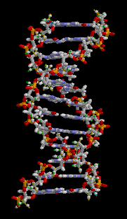
Macromolecules
There are 4 basic kinds of biological macromolecules.
These are carbohydrates (like starch), lipids (like fats), nuclei acids (like DNA), and proteins.
Macromolecules are in your hair and fingernails.
DNA

Slide 146
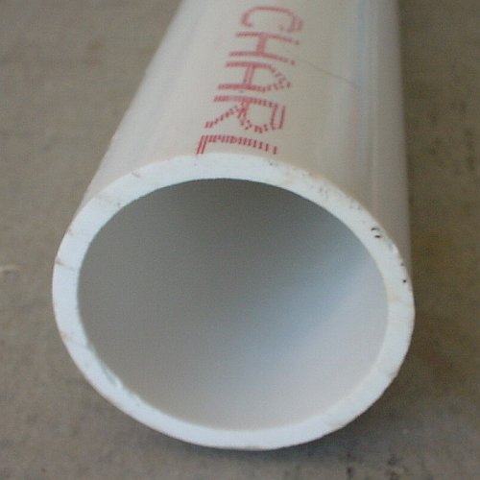
Macromolecules
Man-made macromolecules include polymers like PVC and nylon.
PVC
nylon

Slide 147
Network Solids
A network solid is a macromolecule in which the atoms are bonded covalently in a continuous network.
In a network solid there are no individual molecules and the entire crystal is the molecule.

Slide 148
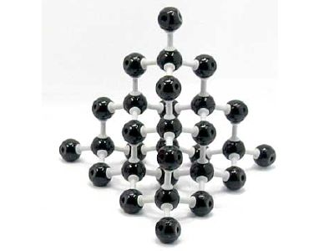
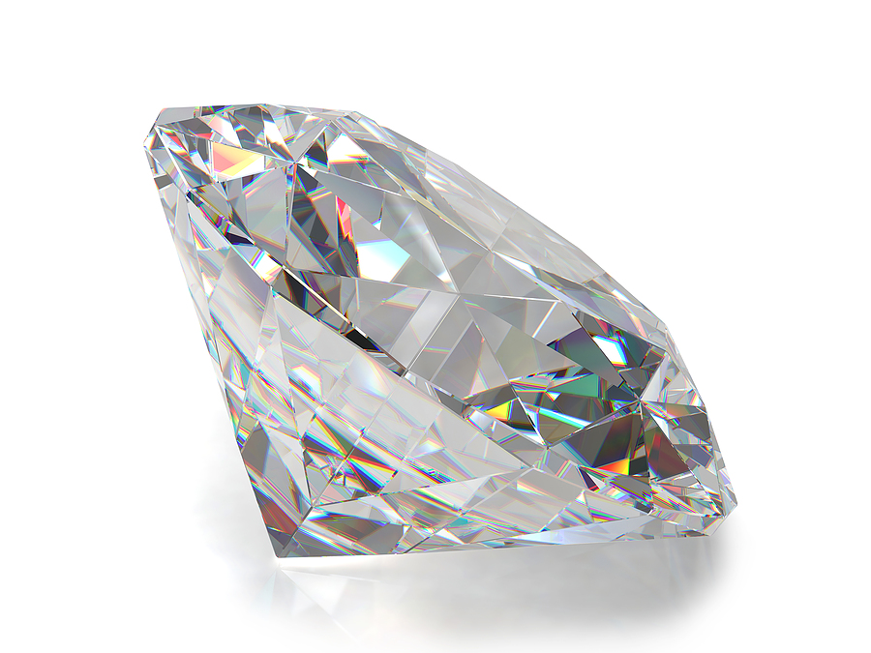
Network Solids
An example of a network solid includes diamond with a continuous network of carbon atoms.

Slide 149
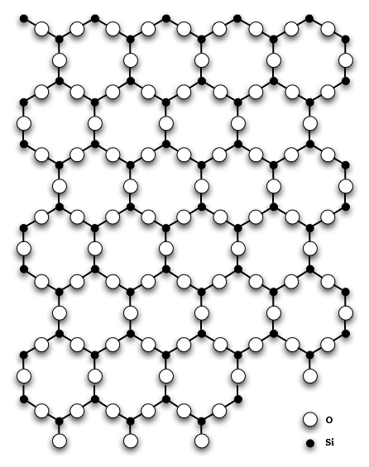
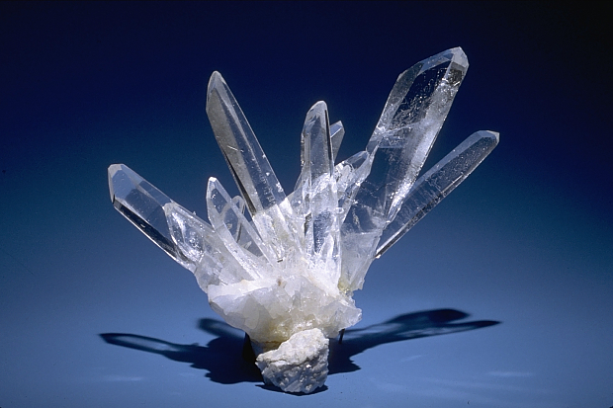
Network Solids
A second example of a network solid is silicon dioxide or quartz with a continuous three dimensional network of SiO₂ units.

Slide 150
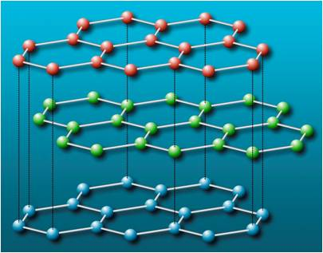
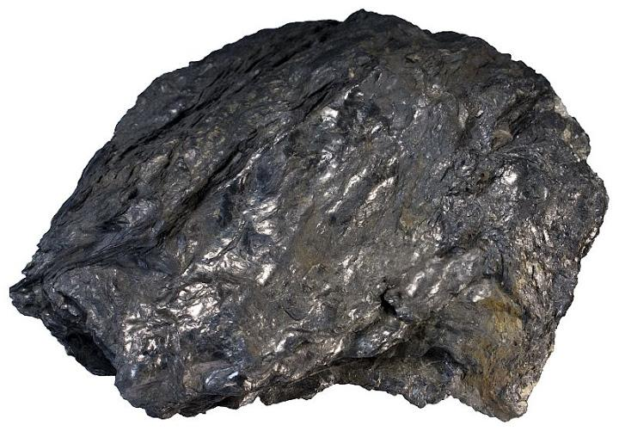
Network Solids
A third example of a network solid is graphite which consists of continuous two dimensional layers covalently bonded within the layer with other bond types holding the layers together.

Slide 151
METALLIC
BONDING

Slide 152
Metallic Bonds: Mellow dogs with plenty of bones to go around
These bonds are best imagined as a room full of puppies who have plenty of bones to go around and are not possessive of any one particular bone.

Slide 153
Metallic Bonds: Mellow dogs with plenty of bones to go around
This allows the electrons to move through the substance with little restriction.
The model is often described as the “metal ions plus a ‘sea’ of mobile electrons."

Slide 154
Metallic Bonds
Metals hold onto their valence electrons very weakly.
The electrons are said to be delocalized.

Slide 155
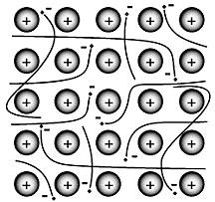
Metallic Bonds

Slide 156
Metallic Bonds
These delocalized electrons are not held by any specific atom and can move easily throughout the solid.
Metal atoms release their valence electrons into a sea of electrons shared by all of the metal atoms. The bond that results from this shared pool of valence electrons is called a metallic bond.

Slide 157
Metallic Bond Properties
Metals are good electrical and thermal conductors due to their free valence electrons.
Metals generally have extremely high melting points and boiling points because it is difficult to pull metal atoms completely away from the group of cations and attracting electrons.

Slide 158
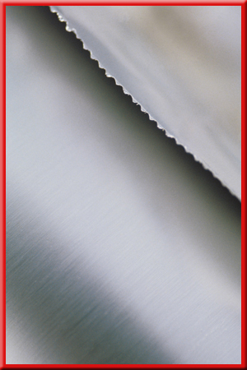
Metallic Bond Properties
Metals are malleable (able to be hammered into sheets).

Slide 159
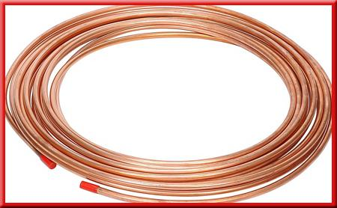
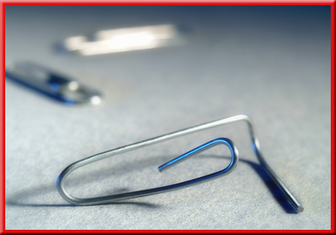
Metallic Bond Properties
Metals are also ductile (able to be drawn into wire) because of the mobility of the particles.

Slide 160
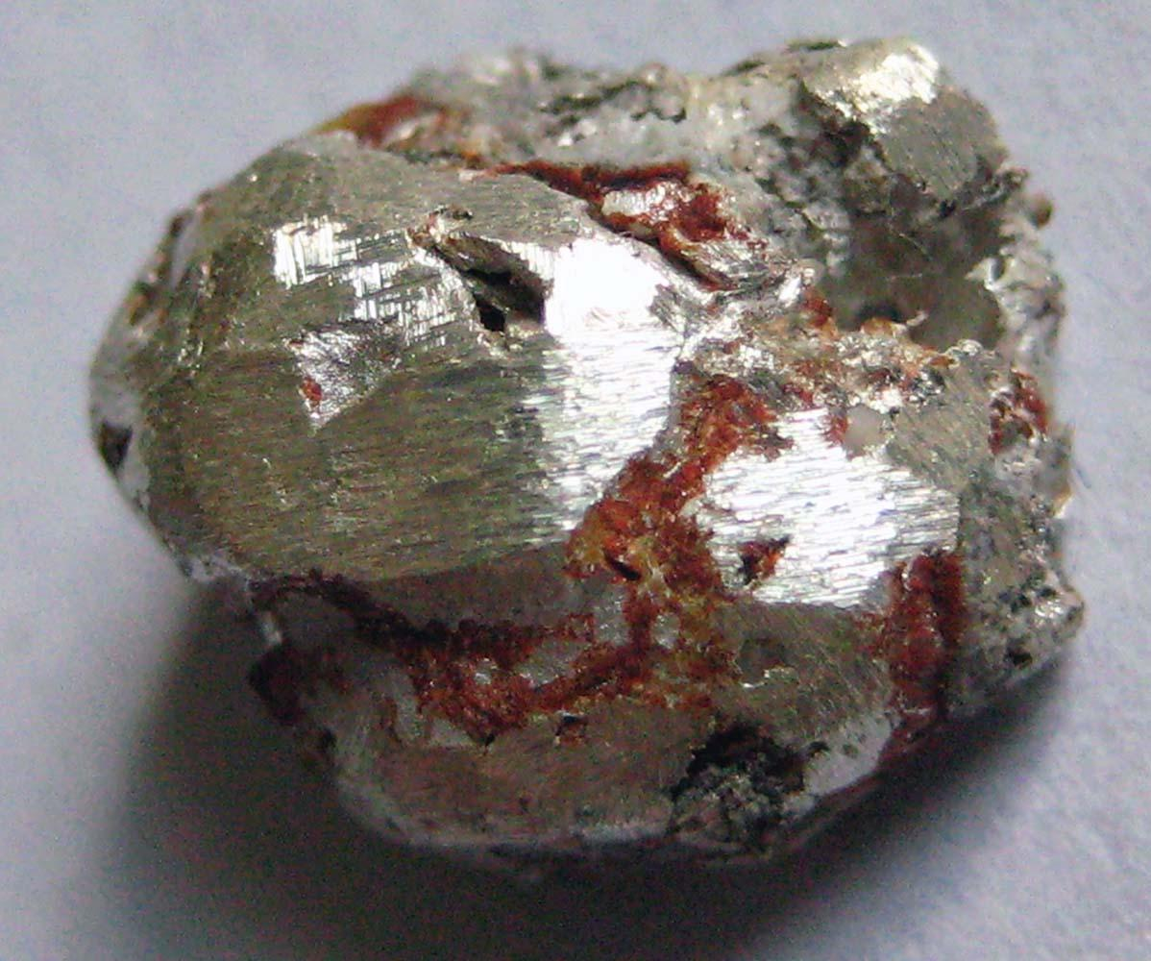
Metallic Bond Properties
Metals have luster (are shiny).

Slide 161
Alloys
A mixture of elements that has metallic properties is called an alloy.
For example, yellow brass used to make a trumpet is 67% copper and 33% zinc. Sterling silver used in silverware is 92.5% silver and 7.5% copper.

