Slide 1
Chemistry: The Study of Matter

Slide 2
What is Chemistry?
Chemistry is the science that investigates and explains the structure and properties of matter.
This includes its composition, properties, and the changes it undergoes.

Slide 3
What is Chemistry?
Applied Chemistry is the using chemistry to attain certain goals, in fields like medicine, agriculture, and manufacturing.
Pure chemistry gathers knowledge for knowledge sake.

Slide 4
Types of Chemistry
Analytical Chemistry studies the composition of substances.
Inorganic Chemistry studies substances without carbon.
Organic Chemistry studies compounds containing carbon.
Biochemistry is the chemistry of living things.
Physical Chemistry studies behavior of substances.

Slide 5
Chemistry is
a natural science.
a language with its own vocabulary.
a way of thinking.

Slide 6
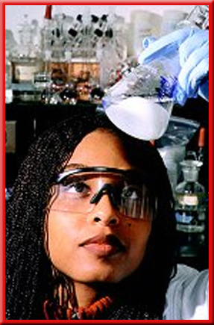
Scientific Method
A scientific method is a systematic approach to answer a question or study a situation.
Starts with observations - noting and recording facts.

Slide 7
Scientific Method
A hypothesis is a possible explanation for what has been observed.
It is an educated guess as to the cause of the problem or answer to the question.

Slide 8
Scientific Method
An experiment is a set of controlled observations that test a hypothesis.
The variable that is changed in an experiment is called the independent variable.

Slide 9
Scientific Method
The variable that you watch to see how it changes as a result of your changes to the independent variable is called the dependent variable.

Slide 10
Scientific Method
There are only two possible answers:
hypothesis is right
hypothesis is wrong
If necessary, modify hypothesis and repeat the cycle.

Slide 11
Cycle repeats many times, and the hypothesis gets more and more certain.
The hypothesis becomes a theory, which is a thoroughly tested model that explains why things behave a certain way.
Observations
Hypothesis
Experiment

Slide 12
Theories can never be proven; they are always subject to additional research.
Observations
Hypothesis
They are useful because they predict behavior.
Experiment

Slide 13
Another outcome is that certain behavior is repeated many times.
A scientific law describes a relationship in nature that is supported by many experiments and for which no exception has been found.
Observations
Hypothesis
Experiment

Slide 14
Observations
Theory
(Model)
Hypothesis
Modify
Experiment
Prediction
Law
Experiment

Slide 15
Assessment Questions
Question
Identify the dependent variable and the independent variable in the following experiments.

Slide 16
Assessment Questions
Question
A student tests the ability of a given chemical to dissolve in water at three different temperatures.
Answer
independent variable:
dependent variable:
temperature
ability to dissolve in water

Slide 17
Assessment Questions
Question
A farmer compares how his crops grow with and without phosphorous fertilizers.
Answer
independent variable:
dependent variable:
presence of phosphorous fertilizer
crop growth

Slide 18
What is Matter?
Matter is anything that takes up space and has mass.
Mass is the measure of the amount of matter that an object contains.

Slide 19
Types of Matter
A sample of matter is either pure - made up of only one kind of matter - or it is a mixture of different kinds of matter.
A pure substance is matter, either an element or compound, with the same fixed composition and properties.

Slide 20
Types of Matter
A mixture is a combination of two or more substances in which the basic identity of each substance is not changed.
Unlike pure substances, mixtures do not have specific compositions.

Slide 21
Properties
The properties of matter describe the characteristics and behavior of matter, including the changes that matter undergoes.

Slide 23
Physical Properties
Physical properties are characteristics that a sample of matter exhibits without any change in its identity.
This property can be observed and measured without changing the substance.

Slide 24
Physical Properties
Examples of the physical properties of a chunk of matter include its:
solubility
boiling point
melting point
density
color
electrical conductivity
and physical state (solid, liquid or gas)

Slide 25
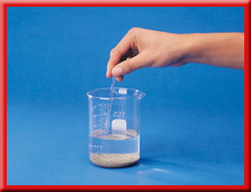
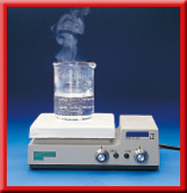
Physical Properties
Salt is soluble in water.
Water boils at 100°C.

Slide 26
Chemical Properties
Chemical properties are those that can be observed only when there is a change in the composition of the substance.
Rusting is a chemical reaction in which iron combines with oxygen to form a new substance, iron oxide.

Slide 27
Assessment Questions
Question
Classify each of the following as a chemical or physical property.
Answers
A. density
physical property
B. reactivity
chemical property
C. color
physical property
D. melting point
physical property

Slide 28
STOP HERE (End of Day 1)

Slide 29
Mixtures
Recall that a sample of matter is either pure - made up of only one kind of matter - or it is a mixture of different kinds of matter.
Mixtures are made up of two or more substances.

Slide 30
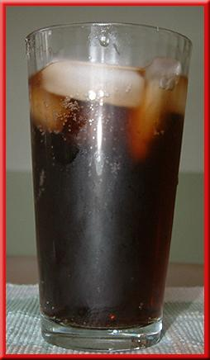
Heterogeneous Mixtures
A heterogeneous mixture is one with different compositions, depending upon where you look.
The components of the heterogeneous mixture exist as distinct regions, often called phases.

Slide 31
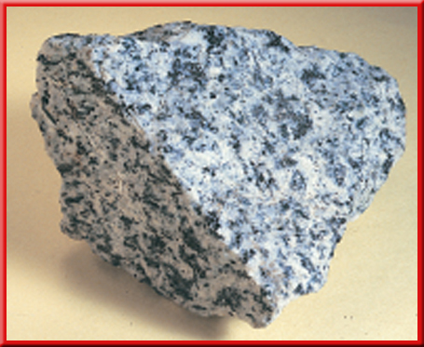
Heterogeneous Mixtures
Examples
chocolate chip cookie
gravel
soil

Slide 32
Homogeneous Mixtures
Homogeneous mixtures are the same or uniform throughout.
Another name for a homogeneous mixture is a solution.
Every part keeps its properties.

Slide 33
Homogeneous Mixtures
Examples
air
Kool-aid
soda
tea
contact-lens cleaner

Slide 34
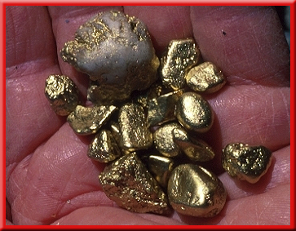
Homogeneous Mixtures
Alloys are solid solutions that contain different metals and sometimes nonmetallic substances.

Slide 35
Homogeneous Mixtures
Like all mixtures, homogeneous mixtures (solutions) keep the properties of the components.
They are not easily separated, but they can be separated.

Slide 36
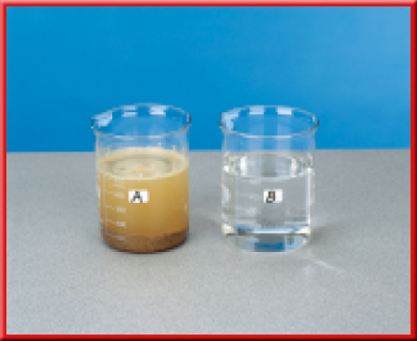
Homogeneous Mixtures
The mixture of table salt and water in the beaker to the right is colorless and appears the same as pure water.
How can you determine if it is a mixture?

Slide 37
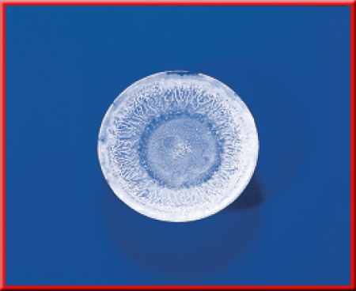
Homogeneous Mixtures
If you were to boil away the water, you would see a white residue. That residue is the salt. Thus, the colorless mixture actually contained two separate substances.

Slide 38
Pure Substances
Recall that pure substance is either an element or compound, with the same fixed composition and properties.

Slide 39
Pure Substances
One type of pure substance cannot be broken down into simpler substances. Such a substance is called an element.
Elements are the simplest kind of matter.
All one kind of atom.

Slide 40
Pure Substances
Another type of pure substance can be broken down into simpler substances. This type of substance is called a compound.
A more complete definition is that a compound is a chemical combination of two or more different elements joined together.

Slide 41
Pure Substances
Compounds can be broken down by chemical methods.
When they are broken down, the pieces, elements, have completely different properties than the compound.

Slide 42
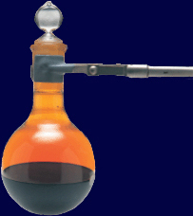
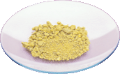
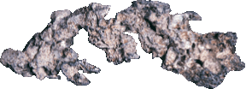
Pure Substances
silver + bromine = silver bromide
Silver and bromine are elements, and silver bromide is a compound.

Slide 43
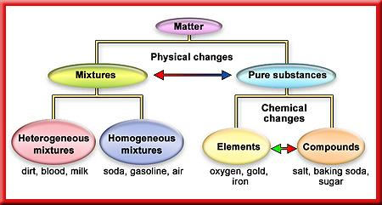
Recap

Slide 44
Assessment Questions
Question
Identify each of the following as either a compound or a mixture.
Answers
A. sand
mixture
B. water
compound
C. fresh orange juice
mixture

Slide 45
Assessment Questions
Question
Determine whether each of the following is a homogeneous mixture, heterogeneous mixture or pure substance.
1. Italian salad dressing
heterogeneous mixture
2. an automobile
heterogeneous mixture

Slide 46
Assessment Questions
Question
Homogeneous mixture, heterogeneous mixture or pure substance?
3. table salt
pure substance (compound)
4. a peach
heterogeneous mixture

Slide 47
Assessment Questions
Question
Homogeneous mixture, heterogeneous mixture or pure substance?
5. Na₂SO₄
pure substance (compound)
6. air
homogeneous mixture

Slide 48
Assessment Questions
Question
Homogeneous mixture, heterogeneous mixture or pure substance?
7. quartz (silicon dioxide)
pure substance (compound)
8. a pencil
heterogeneous mixture

Slide 49
Assessment Questions
Question
Homogeneous mixture, heterogeneous mixture or pure substance?
9. ice water
heterogeneous mixture
10. vegetable soup
heterogeneous mixture

Slide 50
Assessment Questions
Question
Homogeneous mixture, heterogeneous mixture or pure substance?
11. aluminum
pure substance (element)
12. glass
homogeneous mixture

Slide 51
Assessment Questions
Question
Homogeneous mixture, heterogeneous mixture or pure substance?
13. river water
heterogeneous mixture
14. gasoline
homogeneous mixture

Slide 52
Which is it: mixture, element, compound?
Mixture
Element
Compound

Slide 53
Matter
Density is the amount of matter (mass) contained in a unit of volume.
Styrofoam has a low density or small mass per unit of volume.
Density =
mass
volume

Slide 54
Assessment Questions
Question
Solve the following density problems.
1. The density of sugar is 1.59 g/cm³. Calculate the mass of sugar in 15.0 mL.
(1 mL = 1 cm³)
23.9 g

Slide 55
Assessment Questions
2. The density of helium is 0.178 g/L. Calculate the volume of helium that has a mass of 23.5 g.
132 L

Slide 56
Assessment Questions
3. A 14.95 g sample of gold has a volume of 0.774 cm³. Calculate the density of gold.
19.3 g/cm³

Slide 57
Assessment Questions
4. Balsa wood has a density of
0.12 g/cm³. What is the mass of a sample of balsa wood if its volume is 134 cm³?
16 g

Slide 58
Assessment Questions
5. The density of ice at 0 °C is
0.917 g/cm³. Calculate the volume of
145 g of ice.
158 cm³

Slide 59
Assessment Questions
6. The density of a sample of lead is found by the process of water displacement. A graduated cylinder is filled with water to the 30.0 mL mark. The cylinder with the water is placed on an electronic balance and weighs 106.82 g.

Slide 60
Assessment Questions
6 cont. A piece of lead is added to the cylinder. The cylinder is reweighed with the water and the lead and the scale reads 155.83 g. The volume of all the material in the cylinder is 34.5 mL. Calculate the density of the lead.
10.9 g/mL

Slide 61
Assessment Questions
7. The density of an unknown solid was found by the process of water displacement. The object was massed on an electronic balance. The balance reads 125 g. 50.0 cm³ of water was poured into a 100.0 mL graduated cylinder.

Slide 62
Assessment Questions
7 cont. The unknown sample was then gently placed into the graduated cylinder. The volume in the cylinder rose to 60.7 cm³. Calculate the density of the unknown solid.
11.7 g/cm³

Slide 63
STOP HERE (End of Day 2)

Slide 64
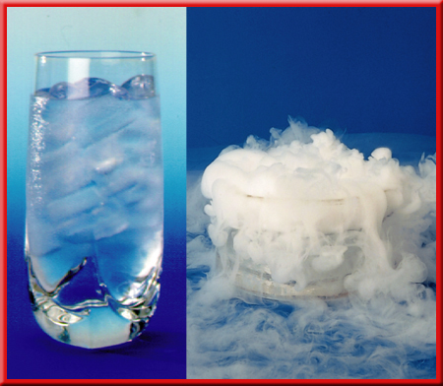
Physical Changes
A physical change is a change in matter that does not involve a change in the chemical identity of individual substances.
The matter only changes in appearance.

Slide 65
Physical Changes
Examples
boiling
freezing
melting
evaporating
dissolving
crystallizing

Slide 66
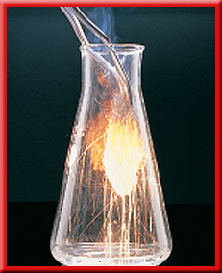
Chemical Changes
A chemical property always relates to a chemical change, the change of one or more substances into other substances.
Another term for chemical change is chemical reaction.

Slide 67
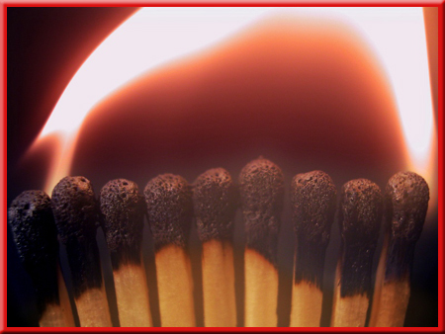
Indications of a Chemical Reaction
Energy absorbed or released
Color change
Formation of a precipitate - solid that separates from solution
Formation of a gas

Slide 68
Assessment Questions
Question
Identify each of the following as an example of a chemical change or a physical change.
1. Moisture in the air forms beads of water
on a cold windowpane.
physical

Slide 69
Assessment Questions
Question
2. An electric current changes water into hydrogen and oxygen.
chemical
3. Yeast cells in bread dough make carbon
dioxide and ethanol from sugar.
chemical

Slide 70
Conservation of Mass (Matter)
All matter is made of atoms, and any chemical change involves only a rearrangement of the atoms. Atoms do not just appear. Atoms do not just disappear.
This is an example of the law of conservation of mass (or matter), which says that in a chemical change, matter is neither created nor destroyed.

Slide 72
Assessment Questions
Question
A reaction between sodium hydroxide and hydrogen chloride gas produces sodium chloride and water. A reaction of 22.85 g of sodium hydroxide with 20.82 g of hydrogen chloride gives off 10.29 g of water. What mass of sodium chloride is formed in the reaction?
33.38 g

Slide 73
Chemical Changes & Energy
All chemical changes also involve some sort of energy change.
Energy is either taken in or given off as the chemical change takes place. Energy is the capacity to do work.
Work is done whenever something is moved.

Slide 74
Chemical Changes & Energy
Chemical reactions that give off heat energy are called exothermic reactions.
Chemical reactions that absorb heat energy are called endothermic reactions.

Slide 75
Chemical Changes & Energy
Freezing, condensation and deposition are exothermic.
Melting, evaporation and sublimation are endothermic.

Slide 76
Assessment Questions
Question
State whether the following are endothermic or exothermic processes.
1. melting of ice
endothermic
2. combustion of gasoline
exothermic

Slide 77
Assessment Questions
Endothermic or exothermic?
3. Natural gas is burned in a furnace.
exothermic
4. When solid potassium bromide is dissolved in water, the solution gets colder.
endothermic

Slide 78
Assessment Questions
Endothermic or exothermic?
5. When concentrated sulfuric acid is added to water, the solution gets very hot.
exothermic

Slide 79
Conservation of Energy
Energy can be neither created nor destroyed in ordinary changes (not nuclear); it can only change form.

